Slide 1

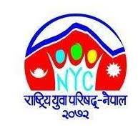

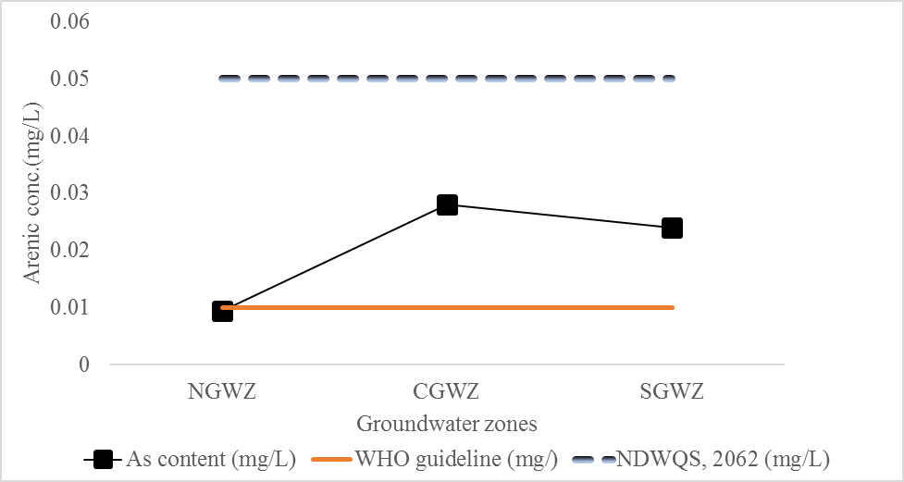
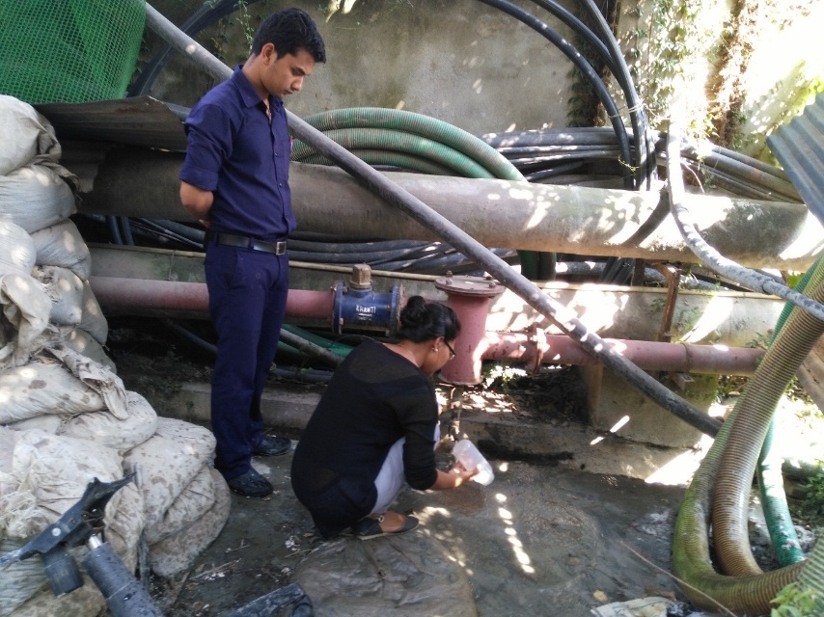
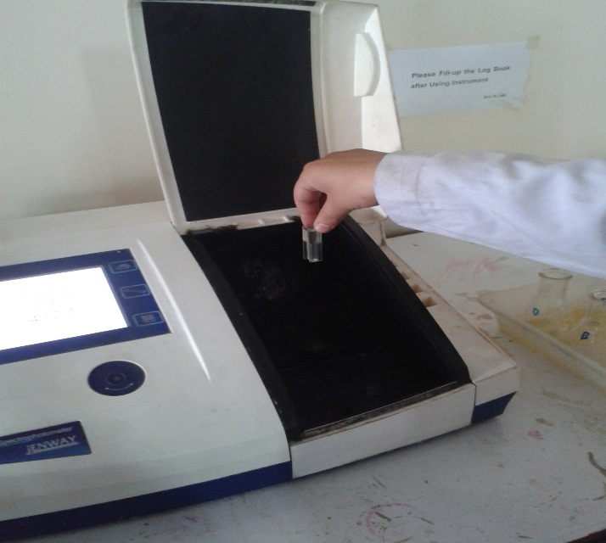
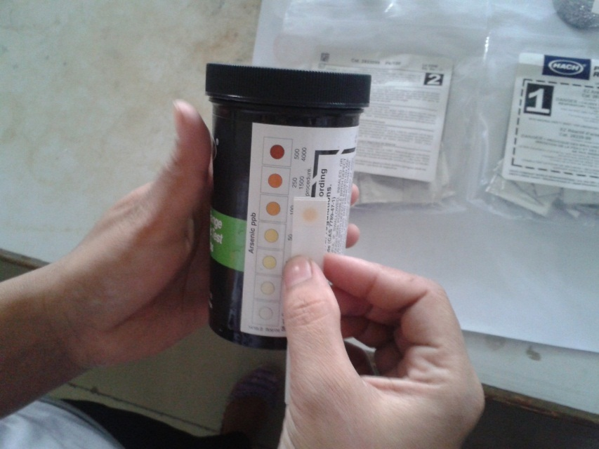
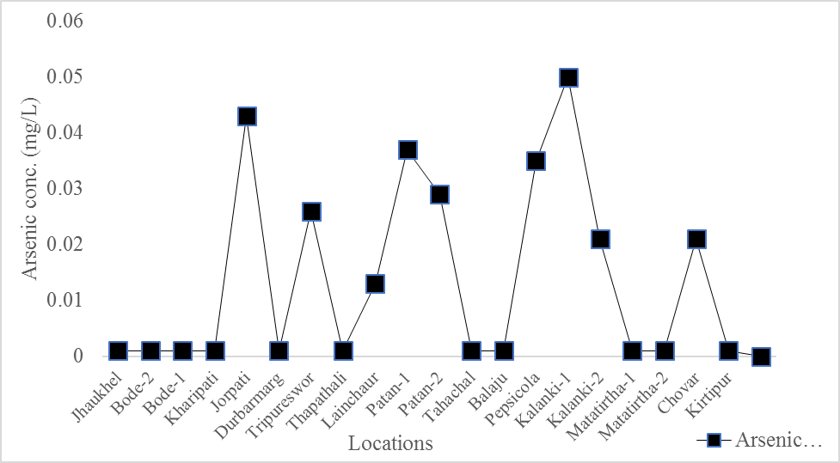
ASSESSMENT OF ARSENIC CONTENT IN DEEP GROUNDWATER OF KATHMANDU VALLEY, NEPAL
Sushila Gwachha*, Dr. Sujen Man Shrestha**
*Lecturer, Departrment of Environmental Science, Khwopa College (T.U.) (gwachha.koju@gmail.com)
* * Senior Scientific Officer, Nepal Academy of Science and technology, Khumaltar, Nepal
ABSTRACT
Contamination of drinking water by arsenic is a growing problem of modern world. This study was conducted in 20 deep groundwater (>200m) samples of Kathmandu Valley to assess the arsenic content of different groundwater zones and to determine the relationship of arsenic with other parameters. Samples were collected in post-monsoon season of 2016. Random sampling method was applied for the collection of samples. Atomic absorption Spectrometry (AAS) was used to measure arsenic concentration. Ultra-Violet spectrometry was used to measure the ammonia and nitrate through nesslerization method and brucine method respectively. High concentration of arsenic beyond the WHO guideline was found in 45% of the samples. The mean arsenic concentration was found to be 0.02 mg/L. This concentration is below the National Drinking Water Quality Standard, 2062 (0.05 mg/L) but higher than the WHO guideline (0.01 mg/L). Arsenic concentration showed spatial variation. Maximum concentration of arsenic was found in Central Groundwater Zone (0.028 mg/L) followed by Southern Groundwater Zone (0.024 mg/L) and then Northern Groundwater Zone (0.009 mg/L). Arsenic concentration was found to be positively correlated with pH (r = 0.32), EC (r = 0.38), turbidity (r = 0.04), iron content (r = 0.52), manganese (r = 0.19), ammonia (r = 0.27) but negatively correlated with nitrate content (r = -0.14). Further studies are essential to determine the arsenic mobilization and speciation in the groundwater of Kathmandu Valley.
Key Words: Arsenic, Deep Groundwater, Kathmandu Valley, Random sampling
SCIENCE, INFORMATION AND TECHNOLOGY NATIONAL YOUTH CONFERENCE
JUNE 15-17, 2018
SITNYC2018
OBJECTIVES
To assess arsenic content in deep groundwater of Kathmandu Valley.
To assess the spatial variation of arsenic in different groundwater zones.
To study the relationship of arsenic content with other parameters of groundwater.
Figure 6: comparison of arsenic concentration with standards
MATERIALS AND METHODS
Altogether 20 samples were collected from deep groundwater wells of Kathmandu Valley using stratified random sampling method; 5 from Northern Groundwater Zone, 12 from Central Groundwater Zone and 4 from Southern Groundwater Zone as classified by JICA/ENPHO, 1990. Temperature C, pH, conductivity (µs/cm), salinity (mg/L) and Total Dissolved Solids (mg/L) were measured with HANNA’s pH meter and turbidity (NTU) with turbidimeter. Preliminary test for arsenic was done using HACH test kit. Arsenic (mg/L) , iron (mg/L) and Manganese (mg/L) were measured using Atomic Absorption Spectrometer. Ammonia (mg/L) and Nitrate (mg/L) were measured by nesslerization and brucine method respectively (AAPHA, 2005). Spearman’s correlation coefficient was used to determine the relationship between arsenic and other physicochemical parameters.
Figure 1: sample collection
Figure 2: Nitrate content measurement
Figure 3: Preliminary arsenic measurement by kit method
Figure 7: Variation of arsenic concentration in different GWZs
RESULTS AND DISCUSSIONS
High concentration of arsenic beyond the WHO guideline (0.01 mg/L) was found in 45% of the samples. No samples crossed the guideline value of arsenic of National Drinking Water Quality Standard, 2062.
The mean arsenic concentration was found to be 0.02 mg/L.
Arsenic concentration showed spatial variation. Maximum concentration of arsenic was found in CGWZ (0.028 mg/L) which may be because of high amount of organic matter in the CGWZ due to the fluvio-lacustrine deposits of clayey particles. This suggests that the Arsenic occurrence in the deep groundwater of Kathmandu Valley may be due to the geologic reason.
Arsenic concentration was found to be positively correlated with pH (r = 0.32), EC (r = 0.38), turbidity (r = 0.04), iron content (r = 0.52), manganese (r = 0.19), ammonia (r = 0.27) but negatively correlated with nitrate content (r = -0.14). Similar results were found in earlier studies.
Parameters | pH | EC ((µs/cm) | Turbidity (NTU) | Iron (mg/L) | Manganese (mg/L) | Ammonia (mg/L) | Nitrate (mg/L) | Arsenic (mg/L)
Correlation coefficient (r) | 0.32 | 0.38 | 0.04 | 0.52 | 0.19 | 0.27 | -0.14 | 1
Figure 8: Correlation between arsenic and other parameters
CONCLUSION
High concentration of arsenic beyond the WHO guideline was found in 45% of the samples.
The mean arsenic concentration was found to be 0.02 mg/L.
Arsenic concentration showed spatial variation. Maximum concentration of arsenic was found in CGWZ (0.028 mg/L)
Arsenic concentration was found to be positively correlated with pH, EC, iron content, manganese, ammonia but negatively correlated with nitrate content.
ACKNOWLEDGEMENT
Nepal Academy of Science and Technology, Khumaltar, Nepal
Groundwater Resource Management Committee, Babarmahal ,Kathmandu
Agni Dhakal, AAS Expert, NAST, Khumaltar, Nepal
Bishwonath Acharya, Research Assistant, NAST, Khumaltar, Nepal
Figure 4: Concentration of arsenic in deep groundwater samples
Parameters/ Groundwater zones | EC (µs/cm) | TDS (mg/L) | Salinity (mg/L) | Turbidity (NTU) | Manganese (mg/L) | Ammonia (mg/L) | Nitrate (mg/L)
NGWZ | 641.2 | 224 | 0.15 | 13.82 | 3.9 | 23 | 2.4
CGWZ | 705.4 | 289.5 | 0.34 | 69.81 | 4.5 | 29.0 | 18.3
SGWZ | 332 | 241 | 0.16 | 130.9 | 4.4 | 12.0 | 7.3
REFERENCES
APHA, 2005. Standard Methods for the examination of water and wastewater. 21st Edition, American Public Health Association, American water works Association Water Pollution Control Federation. Published by the American Public Health Association, Washington DC, USA.
JICA, 1990. Japan International Cooperation Agency (JICA), Groundwater management project in Katmandu Valley. Final Report to Nepal water Supply cooperation, pp.186.
WHO, 2004. Guidelines for drinking water quality. Third Edition, WHO Geneva, Switzerland.
LALITPUR, NEPAL
Figure 5: Summary of mean of analyzed physical and chemical parameters
SCIENCE, INFORMATION AND TECHNOLOGY CONFERENCE 2018 (SITNYC-2018)
JUNE 15-17, 2018 LALITPUR, NEPAL

