Slide 1

East Carolina University
Palestine
The Land of Prophets and Spirituality
“Palestine before 1948”
Presented By: Fatema Salem

Slide 2
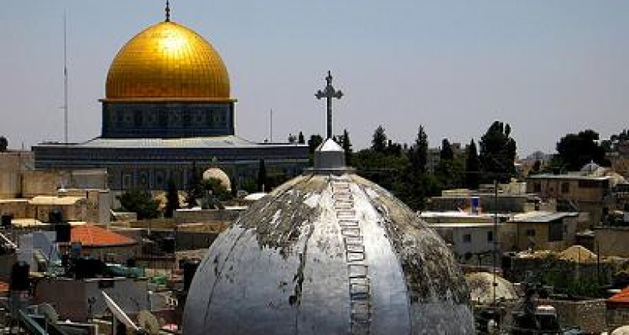
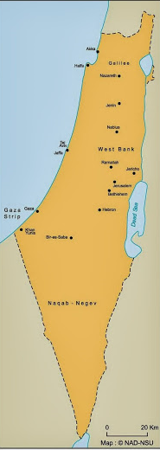

Slide 3

https://www.haaretz.com/.premium-17-golda-meir-quotes-on-her-117th-birthday-1.5356683

Slide 4
Real Women, beautiful women, powerful women think about making the world a better place to live in

Slide 5
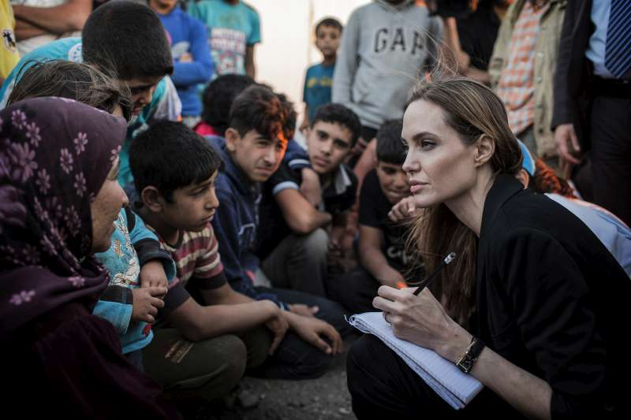
UNHCR Special Envoy Angelina Jolie records the stories of refugees

Slide 6

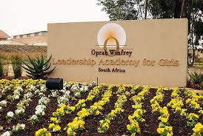
Oprah Winfrey Leadership Academy for Girls – South Africa

Slide 7
But that woman, Golda Mier
Developed her inner resources in a different way.

Slide 8
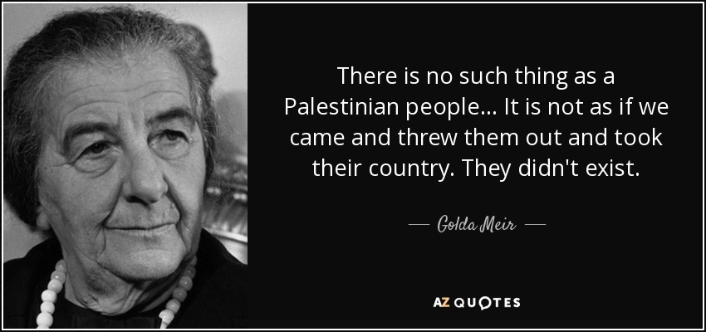
https://www.haaretz.com/.premium-17-golda-meir-quotes-on-her-117th-birthday-1.5356683

Slide 9
Was there a Palestinian or Palestine before 1948?

Slide 10


My granparents from my mom’s side Yousef and Fatema Najem Aldeen . They were born in late 1930s, and were kicked out from their houses in lod, Palestine in 1948 when they were only about 10 years old.

Slide 11
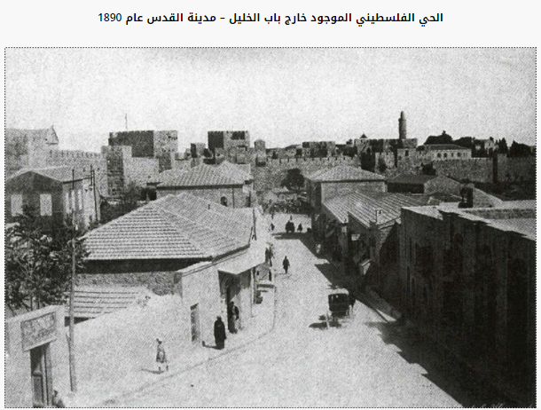
The “ Palestine neighbor hood “ – Jerusalem 1890.
الحي الفلسطيني في القدس – عام 1890
←
http://www.abedkhattar.com/vb/showthread.php?t=328

Slide 12
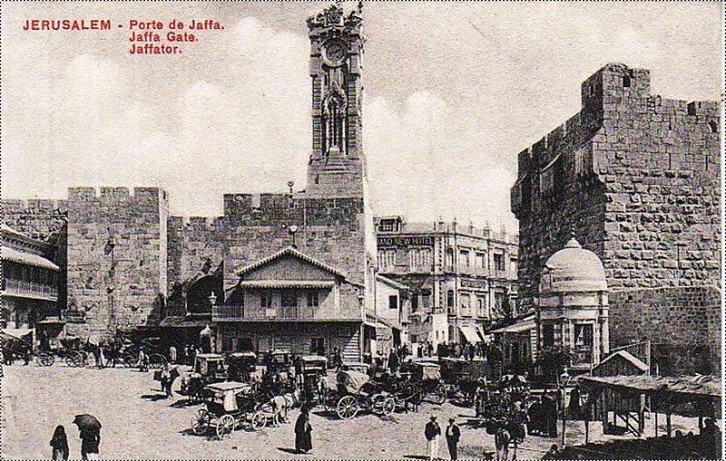
Bab- Alkhalil – Jaffa, Palestine 1920
باب الخليل مدينة يافاو فلسطين عام 1920
http://www.abedkhattar.com/vb/showthread.php?t=328

Slide 13
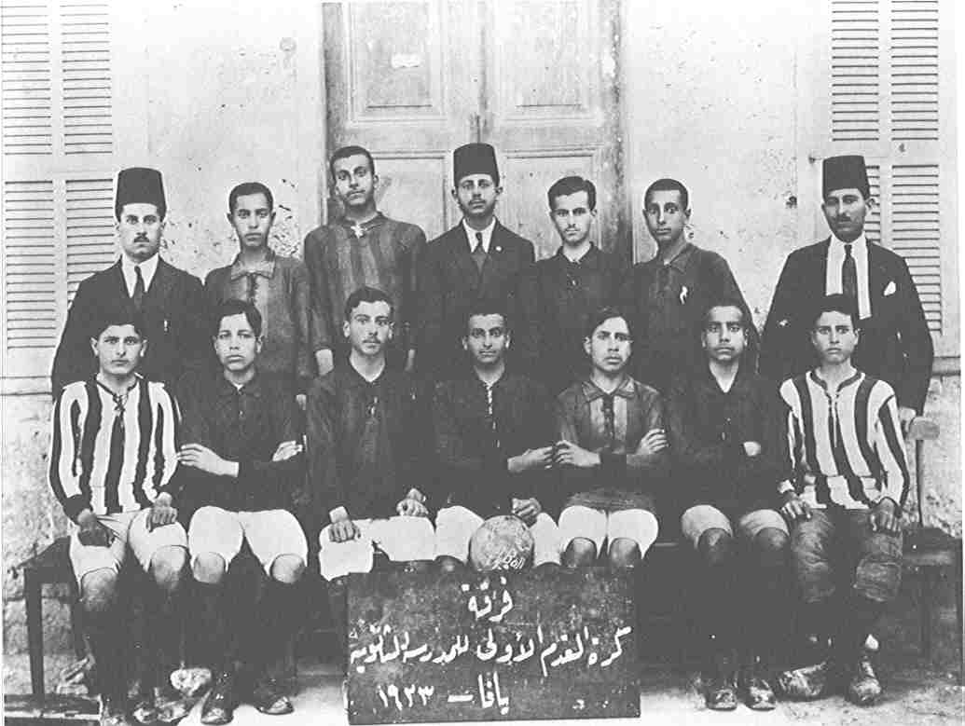
A Palestinian soccer team in Jaffa 1923
فرقة كرة القدم الاولى للمدرسة الثانوية – يافا - 1923
←
https://www.paldf.net/forum/showthread.php?t=1083231

Slide 14
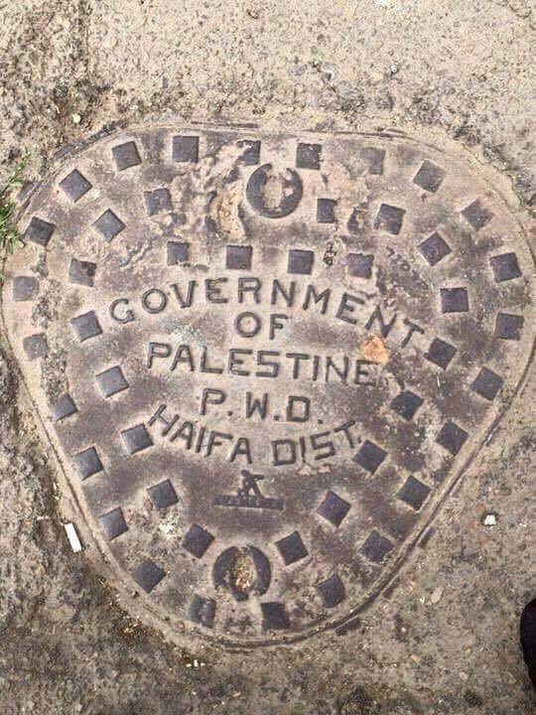
Sewer cover in Jaffa, Palestine .Dating back to the late 1930s .
غطاء منهل – الحكومة الفلسطينية – منطقة حيفا – أواخر 1930م
←
http://www.alquds.co.uk/?p=575991

Slide 15
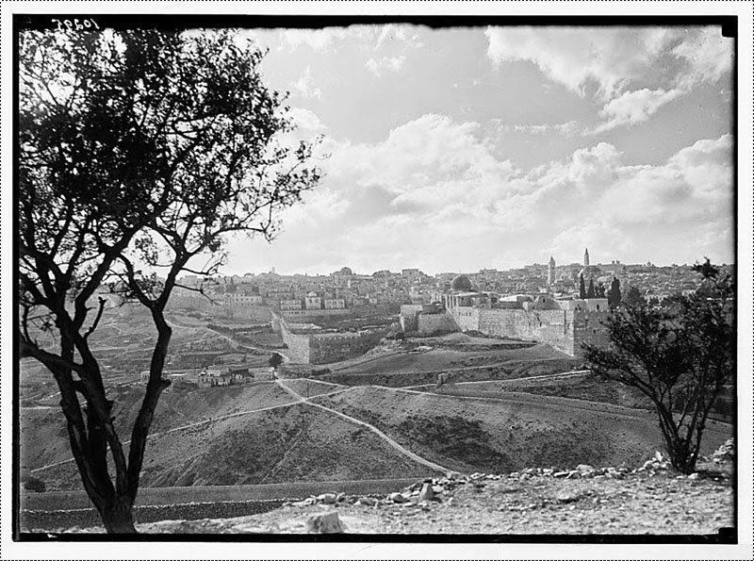
Jerusalem, Palestine ,Dating back to 1934-1939
القدس , فلسطين، بين عامي 1934-1939
http://www.abedkhattar.com/vb/showthread.php?t=328

Slide 16
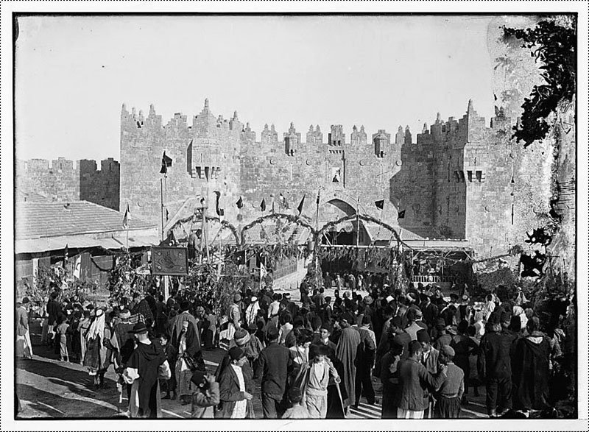
“ Gate of the column” – bab Al Amood during seven-day long religious festival that was celebrated annually by Palestinian Muslims, beginning on the Friday before Good Friday in the old Orthodox Greek calendar
باب العمود وقت انطلاق موكب موسم النبي موسى – مدينة القدس عام 1935
http://www.abedkhattar.com/vb/showthread.php?t=328

Slide 17
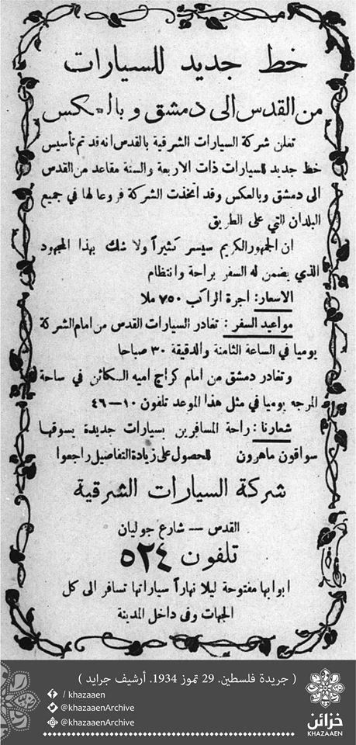
This is a new road that connects Jerusalem with Damascus
Jerusalem , Palestine
07-29-1934
https://www.facebook.com/khazaaen/photos/a.1775891526020437.1073741828.1774150469527876/2046088229000764/?type=3&theater

Slide 18
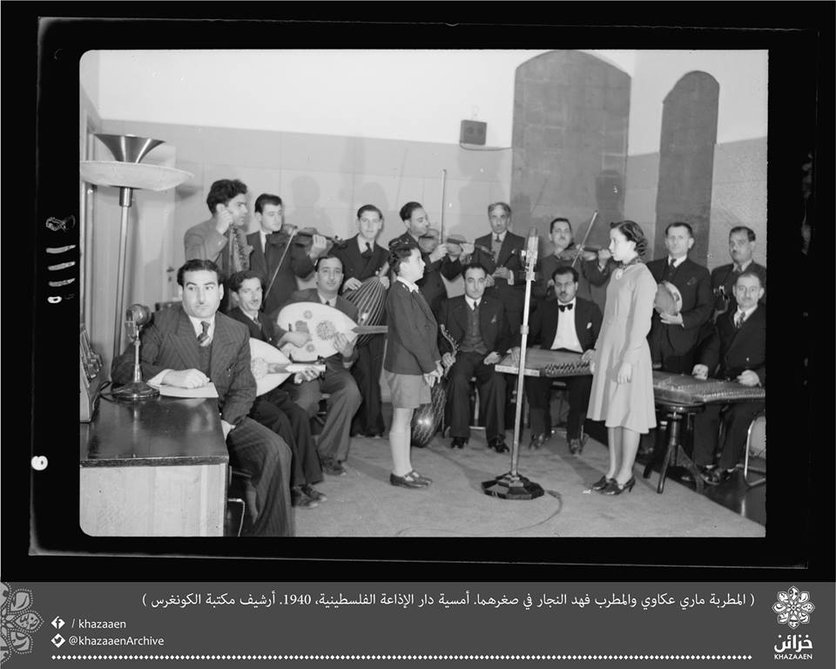
Two children Mary Akkawi, and Fahd Al-Najjar at the Palestinian Radio House in Jerusalem.
Year 1940
https://www.facebook.com/khazaaen/photos/a.1775891526020437.1073741828.1774150469527876/2046088229000764/?type=3&theater

Slide 19
So is it still true that Palestine did not exist before 1948 ?

Slide 20
"No people anywhere in the world would accept being expelled in masse from their own country; how can anyone require the people of Palestine to accept a punishment which nobody else would tolerate?"
Bertrand Russell
Bertrand Arthur William Russell, 3rd Earl Russell, OM, FRS was a British philosopher, logician, mathematician, historian, writer, social critic, political activist and Nobel laureate

