Slide 1
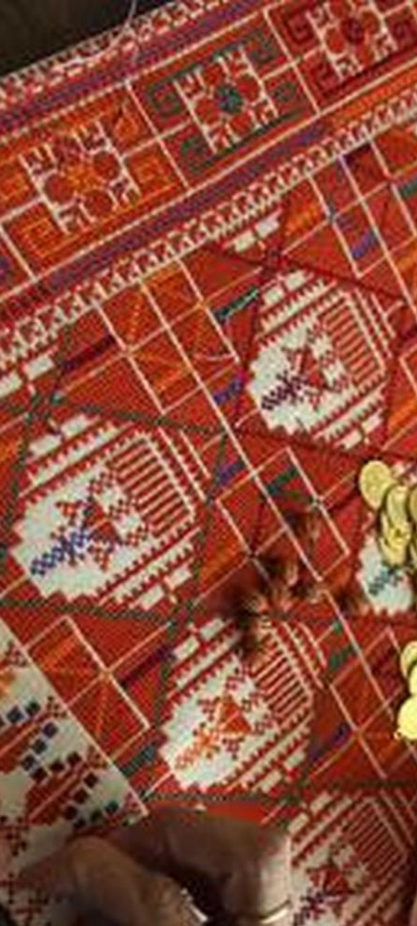

East Carolina University
Palestinian Embroidery
Palestinian Proudness and Threads of History
Presented By: Fatema Salem

Slide 2
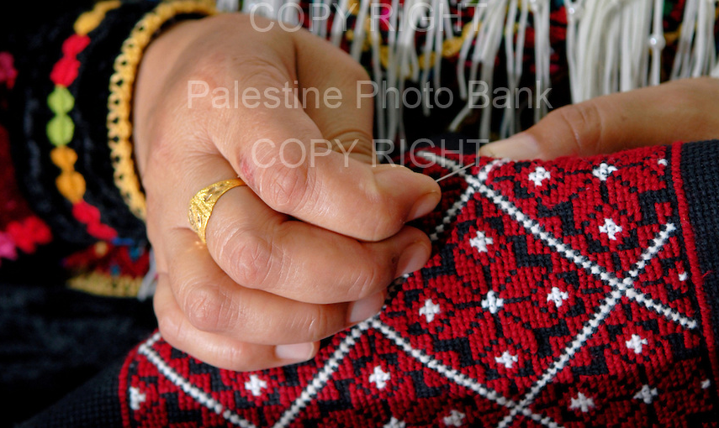
Its more than a Hand Craft

Slide 3
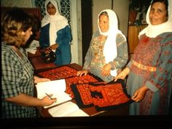
Symbolize Good Health

Slide 4
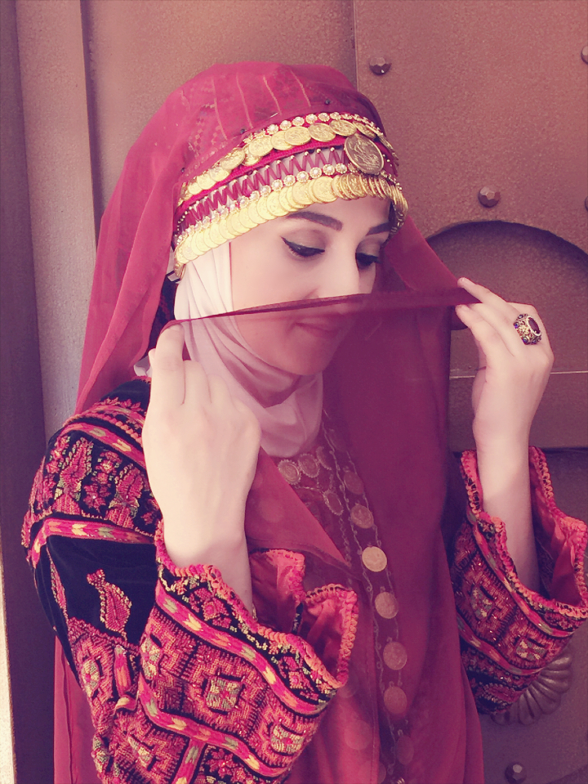
Uniqueness

Slide 5
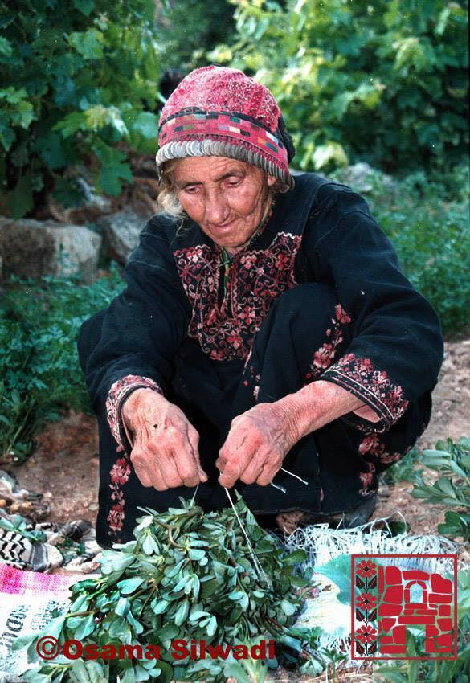
Impressions of their daily surroundings

Slide 6
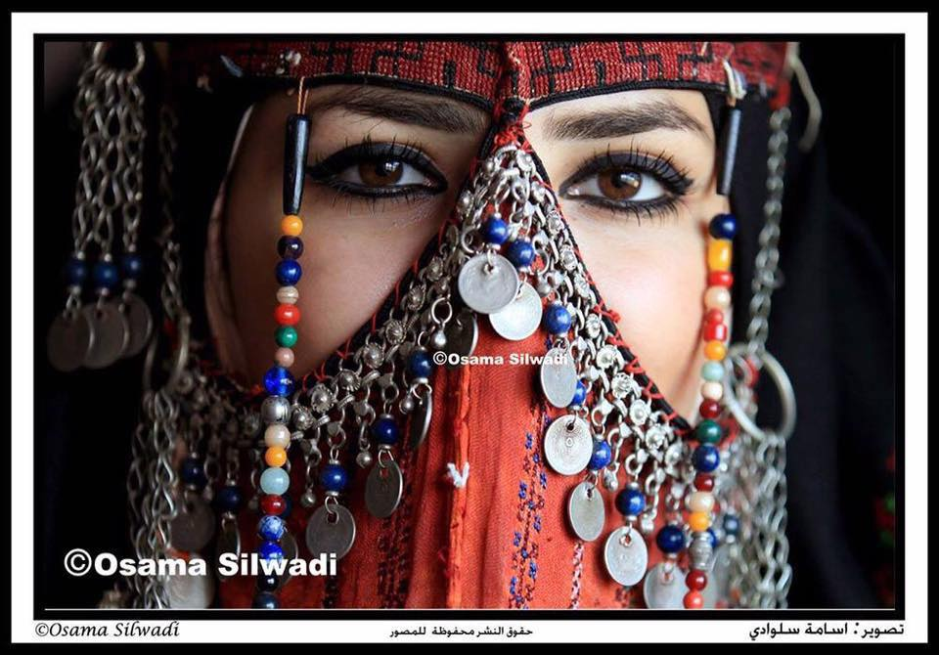
Hope

Slide 7
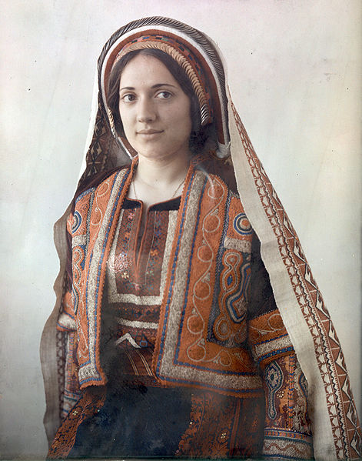
Roots and indigeneity
Palestinian Lady Ramallah
between 1929 and 1946
https://commons.wikimedia.org/wiki/File:Ramallah_woman_15029v.jpg

Slide 8
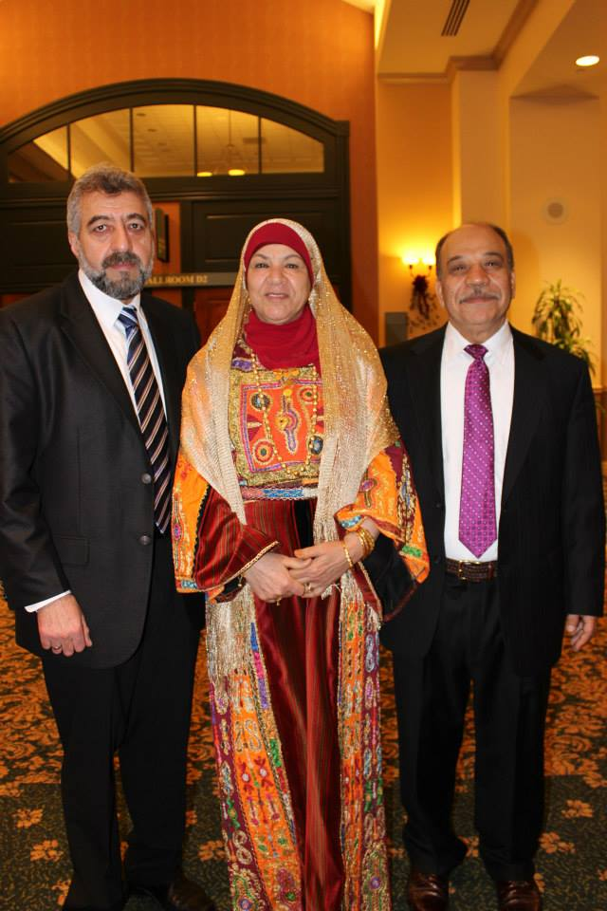
Good Times
Henna Parties
حفلة الحناء

Slide 9
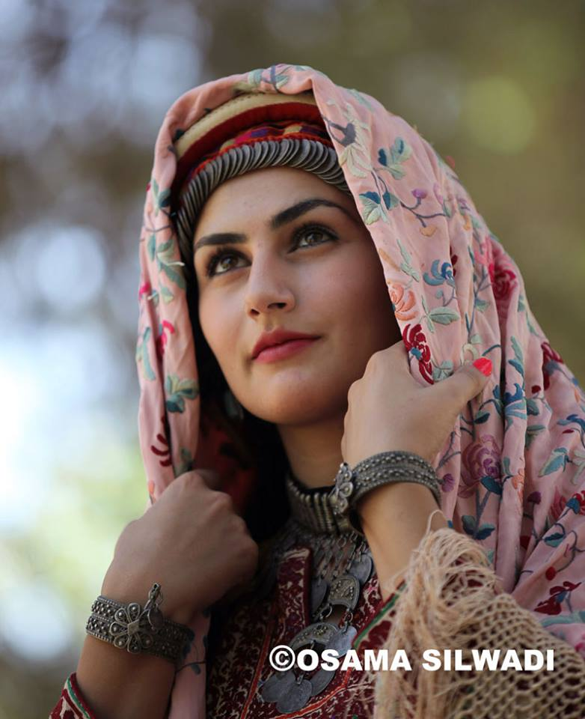
Representation for the Region
Ramallah
رام الله

Slide 10
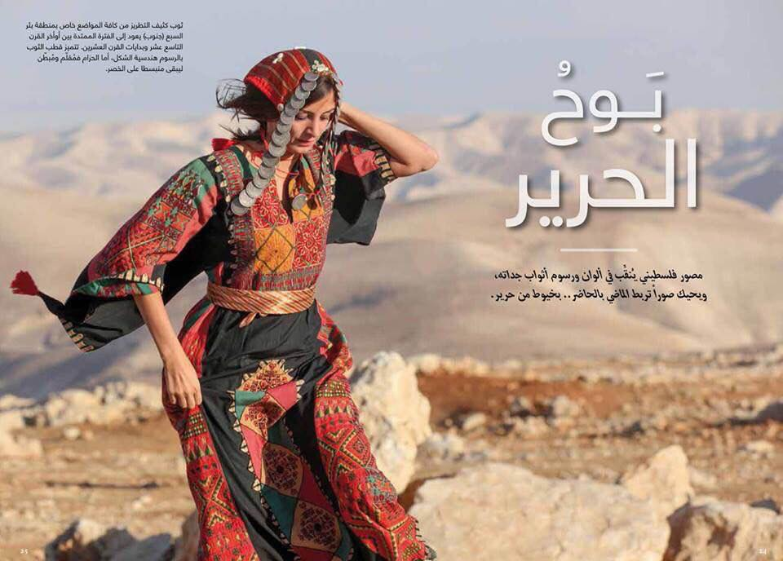
Proudness of the Region
Jericho
أريحا

Slide 11
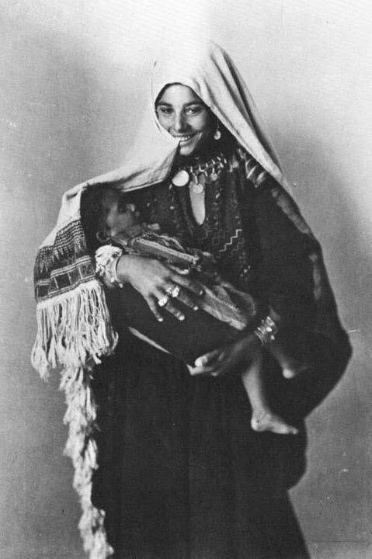
Proudness of the Region
Hebron
الخليل

Slide 12
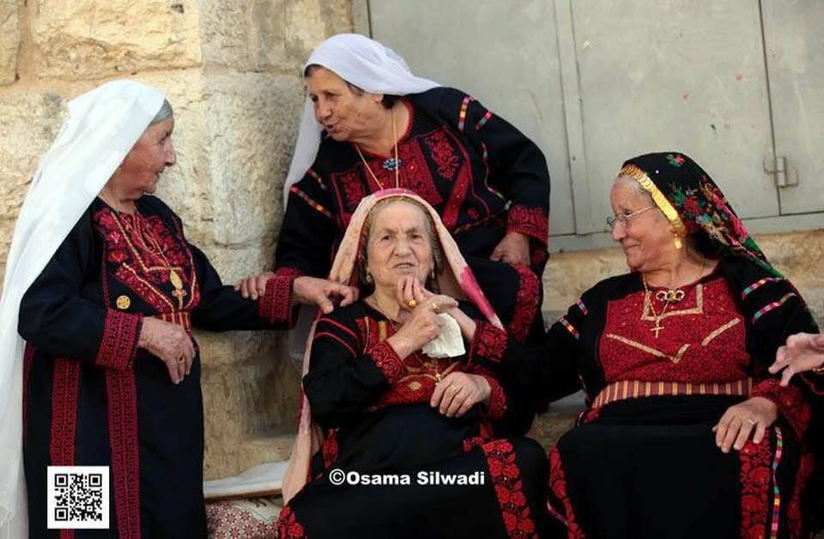
Proudness of the Region
Birzeit
بيرزيت

Slide 13
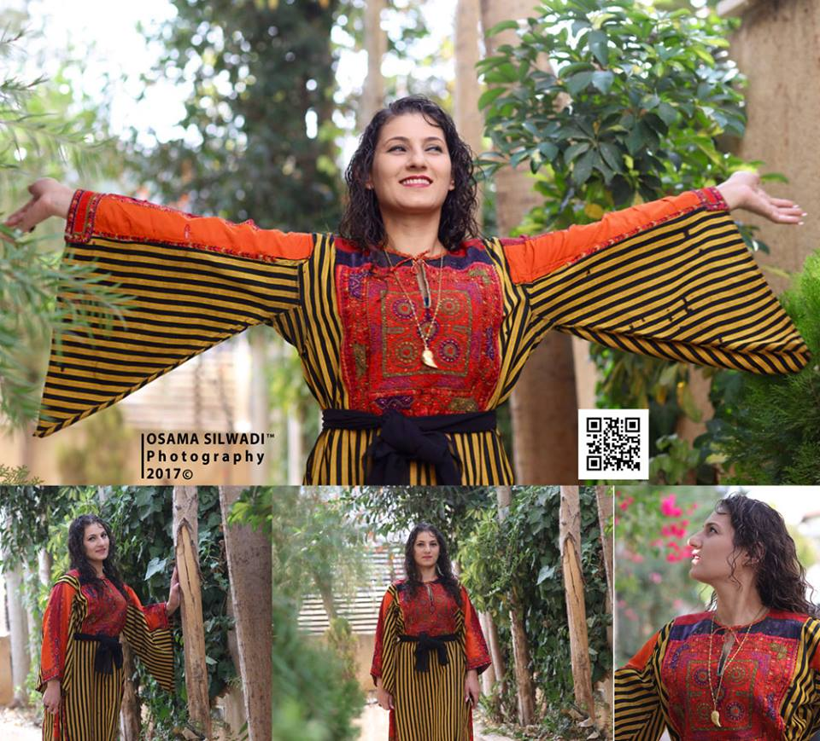
Proudness of the Region
Jerusalem
القدس

Slide 14
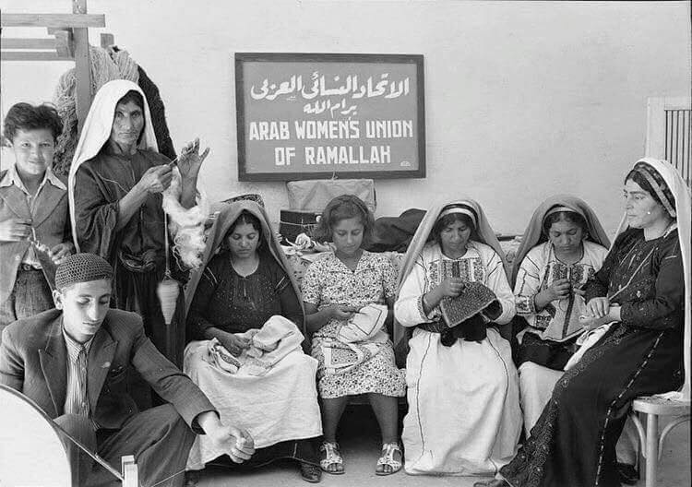
Proudness of the Region
Ramallah
رام الله

Slide 15
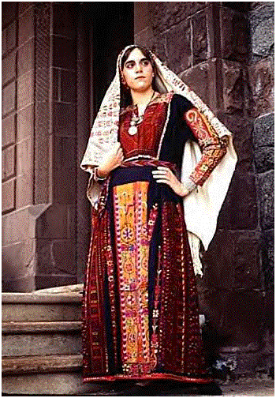
Proudness of the Region
Beit – Dajan - Jaffa
حيفا

Slide 16
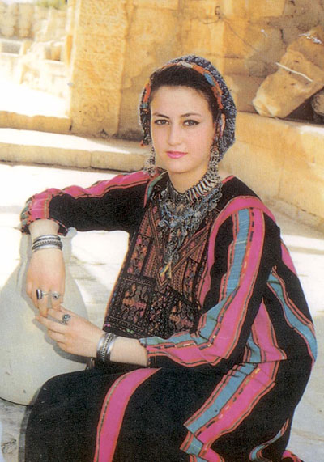
Proudness of the Region
Gaza
غزة

Slide 17
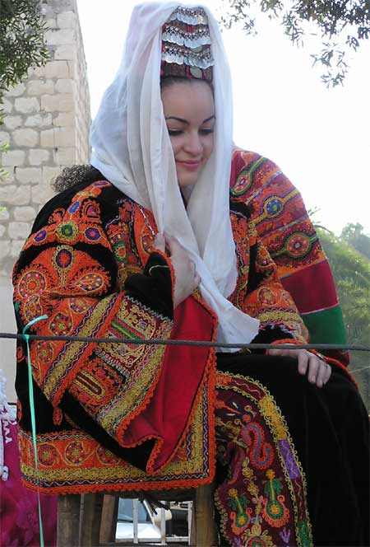
Proudness of the Region
Haifa
حيفا

Slide 18
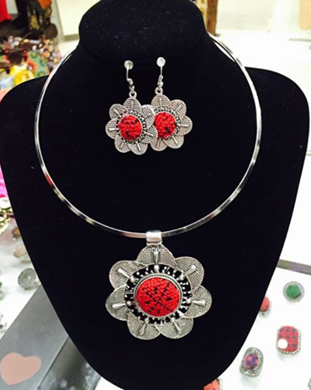
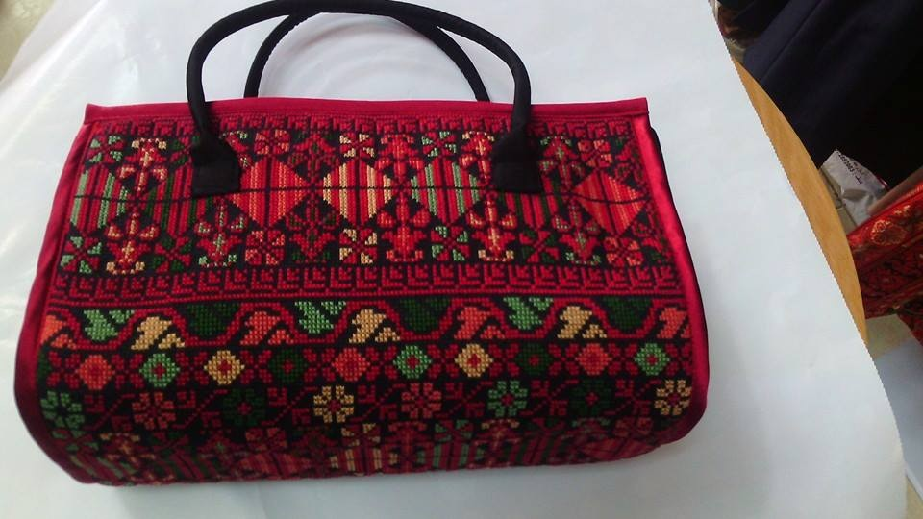
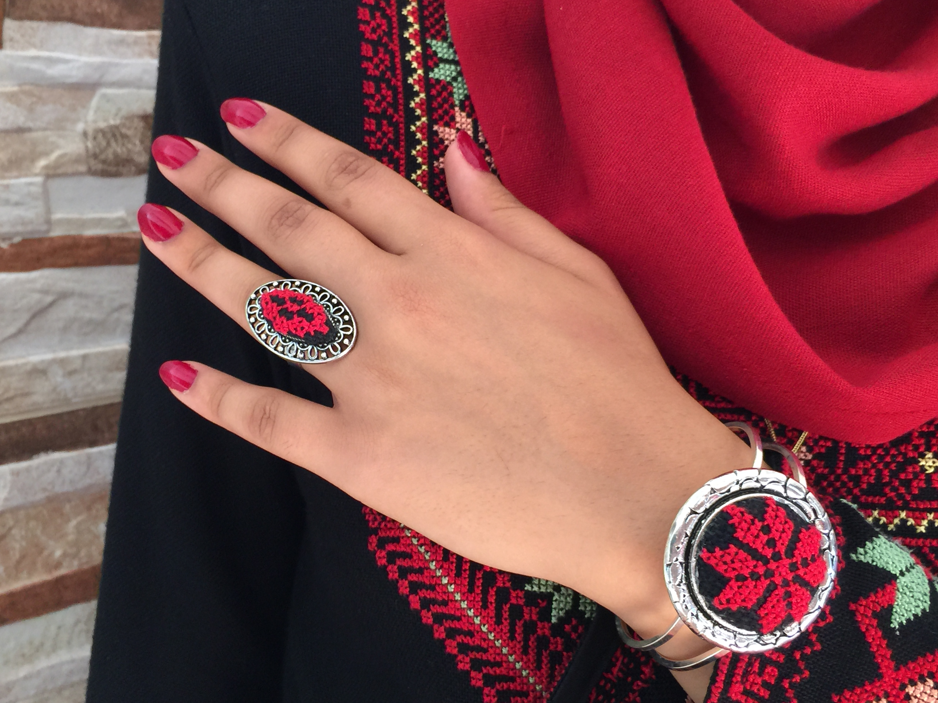
We carry the history of Palestine with us
EVERY DAY

Slide 19
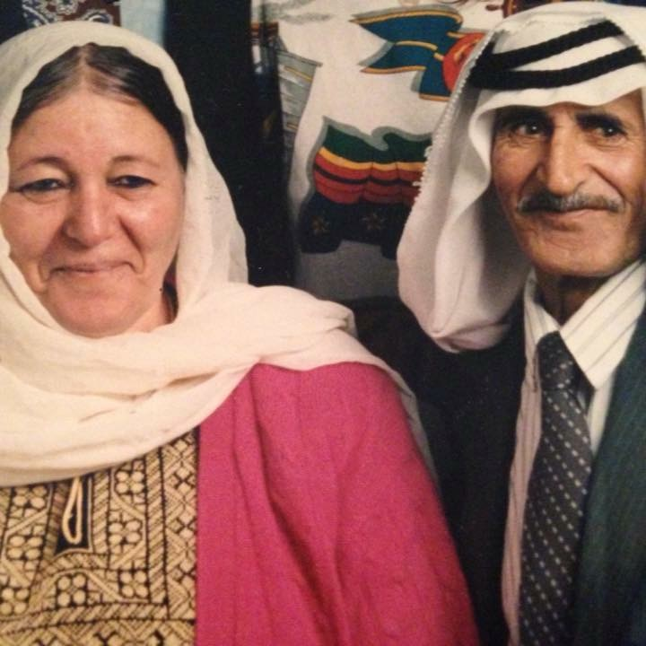
Nostalgia

Slide 20
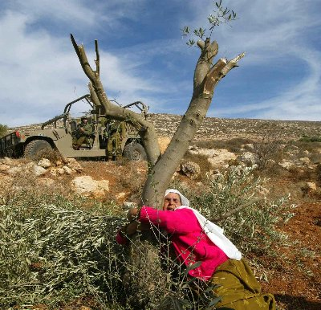
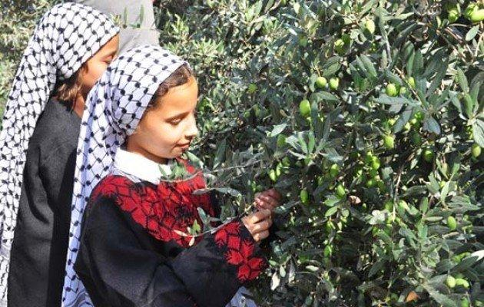
Identity
And
Resistance

Slide 21
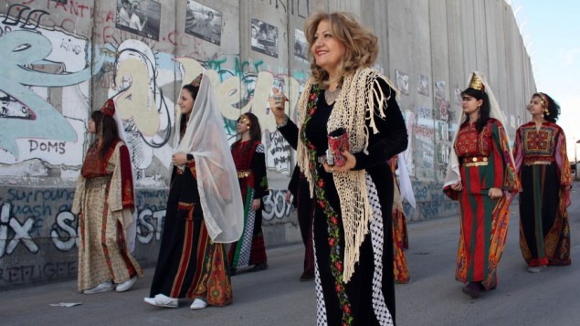
A Future of Freedom

Slide 22

Thank You
From Palestine with love

