Slide 1


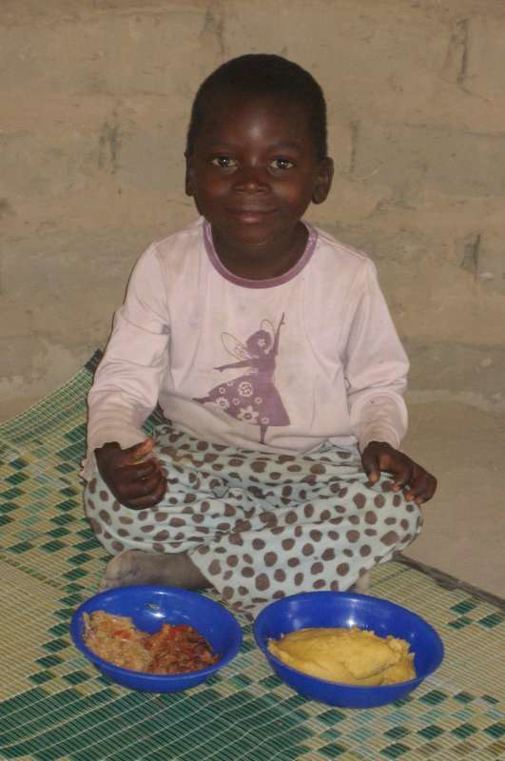
Zim HarvestPlus Country Report
Outline of presentation
Maize consumer preferences in Zimbabwe
ProA maize inbred line development
ProA maize hybrid development
Evaluation of H+ regional trials
Evaluation of HP1005 in Zimbabwe
Status of release of HP1005 in Zimbabwe
Challenges and opportunities
Concluding remarks
Charles Mutimaamba, Purity Mazibuko, Dumisani Kutywayo

Slide 2
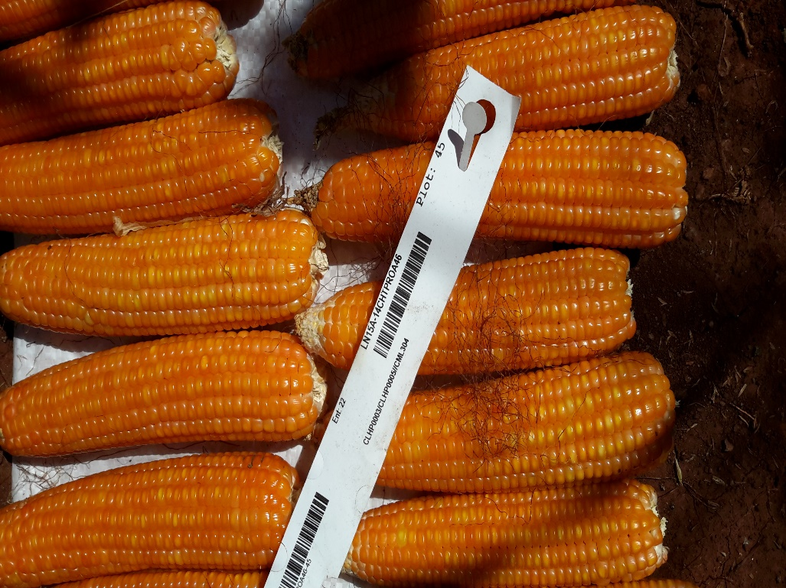
Maize consumer preferences in Zim
Zimbabwe’s average maize per capita consumption of 122 kg/yr is among the highest in Africa (Smale and Jayne, 2003; Smale et al., 2011).
Maize consumer preferences based on grain colour is complex and controversial since yellow maize is commonly associated with the poor (Tshirley and Santos, 1995).
Negative perception has traditionally influenced maize production, consumption and marketing systems in the region including Zim.
Yellow grain and maize meal are presumed to have very little or no demand for human consumption.
Assumption led to government officials and millers discouraging availability of yellow maize and maize meal for purchase by people in normal years (Takavarasha and Jayne, 1994).
10% of urban consumers actually prefer the taste of yellow maize meal, and would buy it if available at the same price as white (Rubey, 1993).

Slide 3
Maize consumer preferences in Zim
62% of urban households in the lowest income quartile would switch to yellow maize if sold at a 26% discount (Rubey, 1993).
39% of households in the highest income quartile would switch to yellow maize if sold at a discount.
94% of rural households were willing to eat yellow maize meal if they knew it was more nutritious (Muzhingi, et al., 2008).
White maize is preferred as sadza while yellow maize is consumed as green mealies (roasted or boiled) in Zim.
These findings clearly demonstrate the potential of successful adoption of orange maize by urban and rural households in Zim.

Slide 4
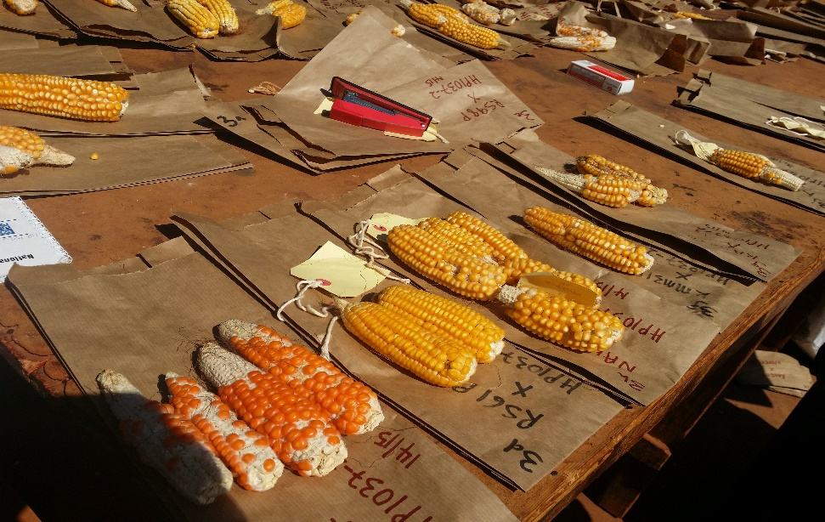
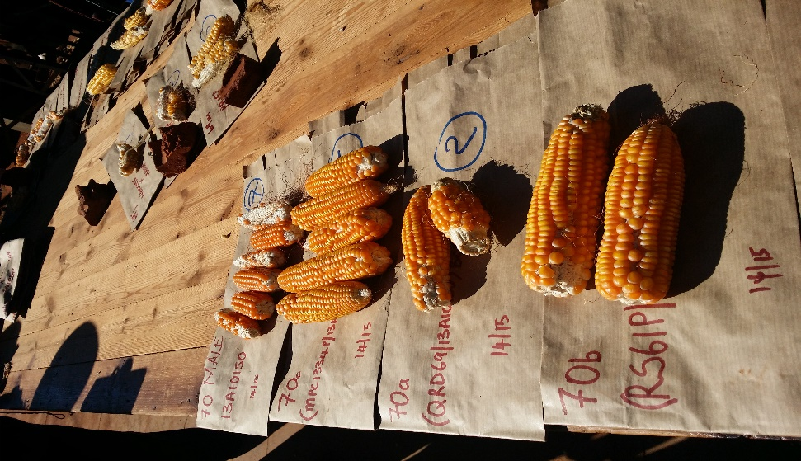
Development of new proA maize inbred lines
28 white & 7 yellow CBI elite lines are being crossed to 29 IITA & 36 CIMMYT proA donors.
Crosses are done at Harare Research Station in summer and at Save Valley in winter.
737 crosses have been developed from 5,500 rows planted at the 2 sites since 2013/14.

Slide 5
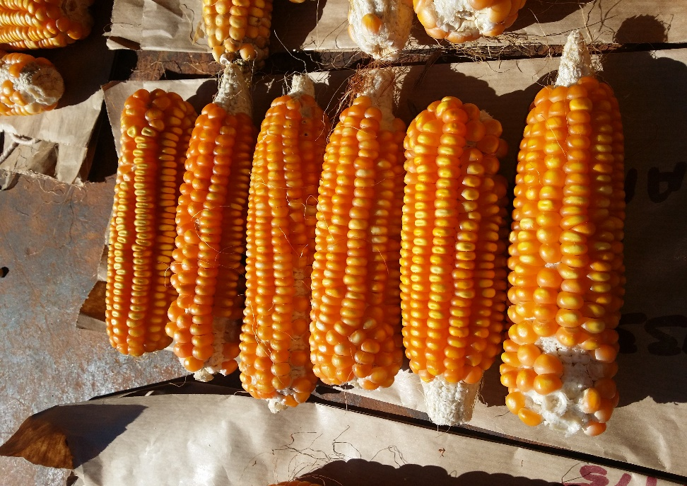
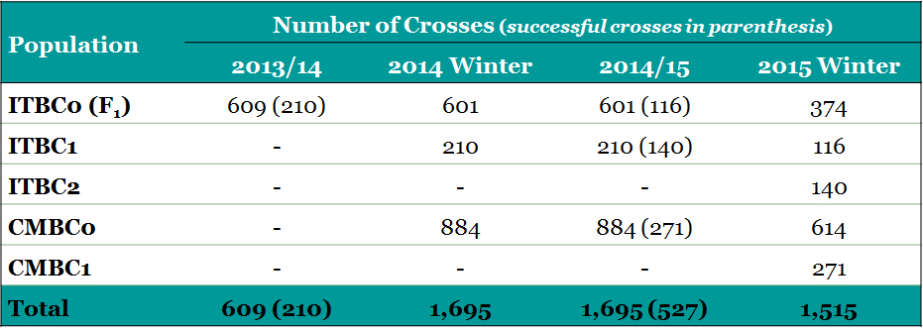
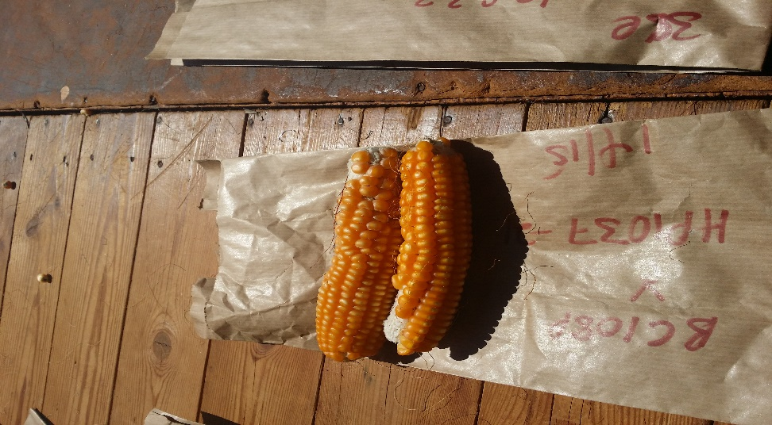
Development of new proA maize inbred lines

Slide 6
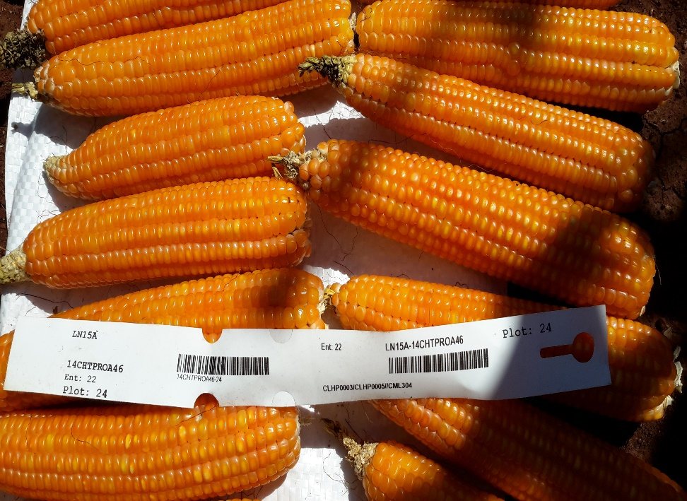
Development of new proA maize hybrids
9 single cross proA testers & 52 proA inbred lines were sourced from CIMMYT Mexico in 2014.
They were crossed at Save Valley in 2014 winter & at Harare in 2014/15 summer.
114 three-way hybrids were successfully produced at Harare.
The hybrids will be evaluated in summer 2015/16 at Harare, Gwebi, Panmure, Kadoma, Makoholi, Matopos, Save Valley and Chisumbanje.

Slide 7
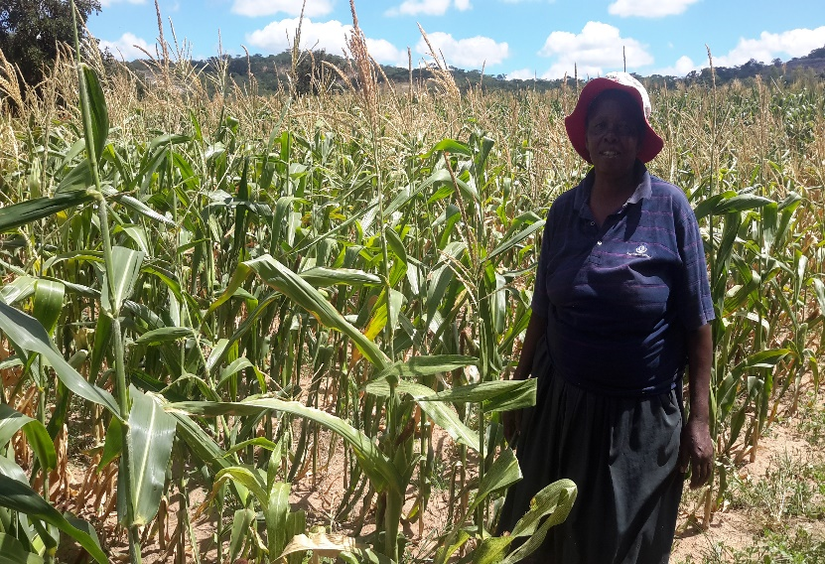
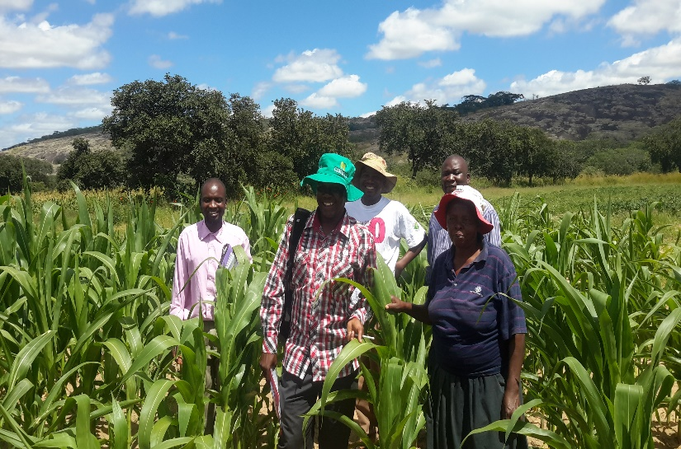
Evaluation of HarvestPlus in Zimbabwe
Season | Trial Series | #Trials | Sites
2012/13 | 12CHTSPROA36 | 1 | Harare
2013/14 | 13CHTPROA EIHYBPROA HP14T201 HP14T202 HP14T301 13HPLET | 13 | Gwebi Kadoma Harare
2014/15 | HP15T3014 HP15T2034 HP15T2014 14CHTPROA47 | 4 | Kadoma

Slide 8
Summary results of the pre-release HP1005
Grain yield (t/ha) of HP1005 relative to checks in advanced variety
trials under high potential environments in 2012/13
HP1005’s relative GY was comparable with ZS261, PAN4M-19, ZS255,
ZS263 & PAN8M-91 and better than SC403 & ZAP51.
Its yield performance was competitive to all checks in individual environments.
Name | %RelGY | Harare Opt | Harare Dis | Gwebi | Bindura OpH | Chisumbanje
ZS265 | 118 | 4.6 | 3.1 | 5.0 | 5.4 | 7.2
SC533 | 111 | 3.4 | 3.5 | 7.6 | 4.8 | 5.0
PAN 8M-91 | 103 | 3.4 | 3.4 | 6.0 | 4.3 | 5.4
ZS263 | 98 | 3.1 | 2.8 | 5.7 | 5.4 | 4.4
ZS255 | 97 | 2.9 | 2.4 | 6.1 | 4.4 | 5.9
PAN 4M-19 | 92 | 2.6 | 2.2 | 6.4 | 5.2 | 4.1
ZS261 | 92 | 3.8 | 2.0 | 5.4 | 3.9 | 5.0
HP1005 | 87 | 2.6 | 3.3 | 5.6 | 3.6 | 3.9
SC403 | 82 | 3.1 | 2.9 | 4.4 | 2.9 | 4.2
ZAP51 | 79 | 3.3 | 3.1 | 4.4 | 2.6 | 3.3
Mean | 100 | 3.4 | 3.2 | 5.8 | 4.1 | 5.3
LSD (0.05) | 16 | 0.9 | 0.6 | 2.0 | 1.9 | 1.2
p |  | *** | *** | *** | *** | ***
Heritability |  | 0.77 | 0.87 | 0.61 | - | 0.75

Slide 9
Summary results of the pre-release HP1005
Grain yield (t/ha) of HP1005 relative to checks in advanced variety
trials under low potential environments in 2012/13
HP1005’s relative GY was comparable with PAN8M-19, ZS265, ZS263 & SC533 and better than SC403, ZAP51 & ZAP61.
Its yield performance was the highest under low N and comparable to all checks in the rest of the environments.
Name | %RelGY | Harare LN | Makoholi | Bindura LpH | Kadoma | Panmure | Matopos | Save V.
SC533 | 124 | 1.1 | 1.2 | 5.2 | 2.6 | 4.5 | 1.8 | 3.9
ZS265 | 109 | 1.1 | 1.1 | 5.5 | 2.4 | 3.3 | 1.4 | 3.7
ZS255 | 108 | 1.1 | 1.0 | 3.8 | 2.5 | 3.2 | 1.5 | 3.4
ZS263 | 94 | 0.8 | 1.0 | 4.2 | 1.6 | 3.4 | 1.6 | 2.6
PAN 8M-91 | 91 | 1.0 | 0.6 | 5.9 | 1.7 | 2.8 | 1.2 | 3.8
HP1005 | 90 | 1.3 | 0.7 | 4.4 | 1.4 | 3.2 | 1.3 | 2.4
SC403 | 90 | 1.0 | 1.0 | 3.6 | 2.3 | 3.1 | 1.1 | 1.7
ZAP61 | 88 | 1.1 | 0.8 | 5.0 | 1.9 | 3.2 | 0.9 | 3.0
ZAP51 | 80 | 0.9 | 0.7 | 3.7 | 2.0 | 3.0 | 1.1 | 1.7
Mean | 100 | 1.0 | 1.0 | 4.6 | 2.0 | 3.4 | 1.5 | 2.9
LSD (0.05) | 17 | 0.3 | 0.6 | 1.8 | 0.9 | 1.1 | 0.5 | 1.6
p |  | ** | *** | ns | *** | *** | *** | ***
Heritability |  | 0.47 | 0.46 | 0.34 | 0.52 | 0.64 | 0.79 | 0.27

Slide 10
Summary results of the pre-release HP1005
Grain yield (t/ha) of HP1005 relative to checks in advanced variety
trials in 2013/14
HP1005’s relative GY was comparable with ZAP51 & SC533, but better than SC635.
Its yield performance was the highest at Matopos and comparable to all checks in the rest of the environments.
Name | %RelGY | Harare |  | Gwebi | Bindura |  | Kadoma | Panmure | Matopos | Makoholi
 |  | Low N | Disease |  | Opt pH | Low pH
PAN53 | 102 | 0.6 | 3.3 | 6.5 | 2.3 | 0.8 | 2.0 | 8.4 | 2.8 | 1.1
ZS265 | 99 | 0.4 | 4.4 | 6.3 | 1.5 | 1.7 | 1.7 | 5.7 | 1.9 | 1.9
SC513 | 97 | 0.7 | 2.4 | 4.7 | 2.7 | 1.1 | 2.2 | 4.5 | 2.0 | 1.7
ZS263 | 92 | 0.6 | 3.1 | 5.1 | 1.9 | 1.3 | 1.7 | 5.3 | 1.9 | 1.4
SC533 | 88 | 0.5 | 2.7 | 5.6 | 1.8 | 1.4 | 2.8 | 4.5 | 1.3 | 1.1
ZAP51 | 80 | 0.5 | 2.5 | 4.3 | 1.8 | 1.2 | 1.5 | 4.7 | 1.6 | 0.8
HP1005 | 74 | 0.4 | 2.3 | 4.1 | 0.4 | 1.0 | 1.9 | 4.9 | 3.0 | 0.8
SC635 | 73 | 0.3 | 2.5 | 5.2 | 1.1 | 1.0 | 1.7 | 5.5 | 1.1 | 1.2
Mean | 100 | 0.6 | 3.4 | 5.1 | 1.9 | 1.8 | 1.9 | 5.7 | 2.2 | 1.5
LSD (0.05) | 15 | 0.4 | 1.2 | 1.5 | 1.3 | 1.1 | 0.8 | 1.8 | 1.2 | 0.7
p |  | ** | *** | *** | * | *** | *** | *** | * | **
Heritability |  | 0.35 | 0.69 | 0.60 | 0.41 | 0.38 | 0.63 | 0.42 | 0.31 | 0.50

Slide 11
Summary results of the pre-release HP1005
Grain yield (t/ha) of HP1005 relative to checks in advanced variety
trials in 2014/15
HP1005 gave a relative GY which was better than PAN3M-01, but comparable with ZS255, ZS273 and ZAP61.
Its yield performance was comparable with all checks at Chisumbanje.
Name | %RelGY | Kadoma |  | Chisumbanje
 |  | Grain Yield | Anthesis Date | Grain Yield | Anthesis Date
SC403 | 104 | 6.9 | 58.6 | 4.2 | 51
ZS263 | 101 | 5.7 | 64.5 | 4.8 | 53.3
ZS265 | 101 | 7.2 | 67.5 | 3.7 | 55.2
ZAP61 | 92 | 5.1 | 65.6 | 4.5 | 55.6
ZS273 | 91 | 4.7 | 70.1 | 4.7 | 55.1
ZS255 | 88 | 6.0 | 61.9 | 3.4 | 53.4
HP1005 | 79 | 3.4 | 67.1 | 4.6 | 54.3
PAN 3M-01 | 75 | 4.4 | 57.1 | 3.4 | 51.7
Mean | 100 | 6.0 | 64.6 | 4.5 | 54.0
LSD (0.05) | 19 | 1.8 | 3.7 | 1.1 | 2.2
p |  | *** | *** | *** | ***
Heritability |  | 0.17 | 0.80 | 0.69 | 0.57

Slide 12
Summary results of the pre-release HP1005
Grain yield (t/ha) of the 10 highest yielding proA hybrids relative to
check varieties in regional trials conducted in Zim in 2014/15
HP1005 was the 8th highest yielding hybrid across site.
It produced the 7th highest yield at ART Farm & under low N at CIMMYT.
The other 9 high-yielding proA hybrids will be tested as pre-release hybrids in national trials in 2015/16.
Variety | ART Farm |  | CIMMYT_LN |  | Rattray Arnold |  | Mean
 | Grain Yield | Rank | Grain Yield | Rank | Grain Yield | Rank | Grain Yield | Rank
SC608 | 12.9 | 1 | 6.1 | 2 | 7.2 | 1 | 8.7 | 1
SC402 | 10.0 | 5 | 6.5 | 1 | 6.4 | 8 | 7.6 | 2
HP26 | 10.6 | 2 | 5.2 | 6 | 7.0 | 4 | 7.6 | 3
HP24 | 9.0 | 21 | 5.4 | 4 | 7.1 | 3 | 7.2 | 4
HP30 | 9.1 | 18 | 4.7 | 19 | 7.2 | 2 | 7.0 | 5
HP49 | 9.7 | 6 | 4.6 | 27 | 6.8 | 6 | 7.0 | 6
HP43 | 9.2 | 17 | 4.9 | 14 | 6.9 | 5 | 7.0 | 7
HP1005 | 9.6 | 7 | 5.2 | 7 | 6.1 | 10 | 7.0 | 8
HP44 | 9.0 | 25 | 4.1 | 41 | 6.7 | 7 | 6.6 | 9
HP39 | 10.2 | 4 | 4.0 | 44 | 5.5 | 19 | 6.6 | 10
HP6 | 9.3 | 13 | 4.8 | 18 | 5.6 | 17 | 6.6 | 11
HP12 | 9.0 | 24 | 4.7 | 21 | 5.9 | 12 | 6.6 | 12
Mean | 8.9 |  | 4.4 |  | 5.1 |  | 7.2
LSD (0.05) | 1.0 |  | 1.6 |  | 1.7
CV | 5.6 |  | 18.2 |  | 16
Heritability | 0.81 |  | 0.41 |  | 0.66

Slide 13
Summary results of the pre-release HP1005
Grain yield and agronomic performance of the 10 highest yielding
proA hybrids relative to check varieties in regional trials in 2014/15
HP1005 had exceptionally good ASI and was comparable with checks and other proA hybrids in agronomic performance.
The pre-release proA hybrids yielded well in comparison to SC402 and gave good agronomic performance.
Variety | GY | AD | ASI | EA | PH | EH | GLS | ET | EPO | RL | TEX
SC608 | 8.7 | 69.4 | -1.2 | 1.9 | 221.7 | 109.8 | 2.2 | 1.1 | 0.5 | 4.1 | 3.5
SC402 | 7.6 | 63.7 | -0.4 | 2.0 | 214.8 | 102.5 | 2.7 | 1.3 | 0.5 | 0.9 | 2.8
HP26 | 7.6 | 67.7 | 0.1 | 1.9 | 225.5 | 116.0 | 3.3 | 1.8 | 0.5 | 12.9 | 2.3
HP24 | 7.2 | 69.9 | 1.0 | 1.4 | 229.7 | 105.9 | 4.3 | 1.5 | 0.5 | 14.3 | 1.5
HP30 | 7.0 | 71.1 | -0.4 | 2.0 | 216.4 | 95.1 | 2.2 | 1.7 | 0.4 | 0.0 | 2.1
HP49 | 7.0 | 68.5 | 0.6 | 2.1 | 221.4 | 110.8 | 3.1 | 1.6 | 0.5 | 0.7 | 2.0
HP43 | 7.0 | 70.2 | -0.3 | 2.2 | 222.0 | 101.5 | 3.6 | 1.2 | 0.5 | 2.0 | 1.8
HP1005 | 7.0 | 70.5 | 0.0 | 1.7 | 238.3 | 125.5 | 3.0 | 1.3 | 0.5 | 5.9 | 1.2
HP44 | 6.6 | 69.8 | 0.5 | 1.8 | 220.2 | 106.5 | 2.8 | 1.6 | 0.5 | 2.1 | 1.5
HP39 | 6.6 | 66.9 | 0.8 | 2.2 | 206.2 | 95.1 | 3.0 | 1.7 | 0.5 | 3.3 | 1.8
HP6 | 6.6 | 71.0 | 0.2 | 1.8 | 222.8 | 107.1 | 3.4 | 1.2 | 0.5 | 0.0 | 1.7
HP12 | 6.6 | 68.6 | 0.4 | 1.9 | 225.0 | 108.9 | 2.8 | 2.2 | 0.5 | 1.1 | 2.0
Mean | 8.8 | 67.6 | 0.0 | 2.2 | 219.0 | 103.6 | 2.5 | 1.6 | 0.5 | 2.8 | 2.0
LSD (0.05) | 1.5 | 2.0 | 1.1 | 0.4 | 13.1 | 11.4 | 1.3 | 0.5 | 0.1 | 8.5 | 0.3
Heritability | 0.70 | 0.83 | 0.16 | 0.62 | 0.82 | 0.76 | 0.48 | 0.58 | 0.43 | 0.08 | 0.89

Slide 14
Summary results of the pre-release HP1005
Mean grain yield (t/ha) of HP1005 relative to check varieties in on-farm
trials in 2014/15
HP1005 was comparable in yield with all checks at all individual and across sites.
It was the 3rd highest yielder in Murehwa, but gave the lowest yield in Bikita together with ZM623Y.
It out-yielded SC608 at Mutoko.
Name | Across Site |  | Murehwa |  | Mutoko |  | Bikita
 | Grain Yield | Rank | Grain Yield | Rank | Grain Yield | Rank | Grain Yield | Rank
HP1005 | 1.6 | 5 | 2.5 | 3 | 1.4 | 5 | 0.8 | 8
CZH116 | 2.2 | 1 | 2.9 | 2 | 1.7 | 3 | 1.9 | 3
CZH1218 | 1.5 | 7 | 2.1 | 5 | 1.1 | 6 | 1.3 | 5
ZM423Y | 1.7 | 3 | 1.4 | 7 | 1.5 | 4 | 2.1 | 2
ZM623Y | 1.4 | 8 | 1.3 | 8 | 1.9 | 1 | 0.9 | 7
ZM523Y | 1.6 | 4 | 2.0 | 6 | 1.8 | 2 | 1.1 | 6
SC608 | 2.1 | 2 | 3.3 | 1 | 0.7 | 8 | 2.3 | 1
SC513 | 1.5 | 6 | 2.3 | 4 | 1.0 | 7 | 1.3 | 4
Mean | 1.7 |  | 2.2 |  | 1.4 |  | 1.5
LSD (0.05) | 1.1 |  | 1.8 |  | 1.0 |  | 1.5
Heritability |  |  | 0.25 |  | 0.39 |  | 0.25

Slide 15
Status of the release HP1005 in Zimbabwe
HP1005 passed DUS tests by Seed Services in 2013.
Data for VCU have been collected and compiled from regional
and national on-station & on-farm trials done in 2011/12,
2012/13, 2013/14 and 2014/15 seasons.
Socio-economics (farmer preference) data are being
consolidated.
Quality (pro-vitamin A content) tests are under way in Mexico.
The release proposal is being compiled and will be ready for
submission to Seed Services by mid-October 2015.
Commercial release is planned for mid-December subject to
approval by the Variety Release Committee.

Slide 16
Challenges and opportunities
Adoption and consumption
  White maize is more preferable to yellow maize.
  Yellow maize is associated with stigma which arose from previous imports of yellow grain with a bad smell caused by poor storage in transit.
  Yellow maize is more preferable for green mealies either for roasting or boiling.
  Feeding schemes conducted by Min. of Health & Child Care and existence of the Food and Nutrition Council.

Slide 17
Challenges and opportunities
Research and development
  Extensive network of research stations covering all agro-ecological regions.
  Rich maize gene bank and well-experienced research personnel
  Robust extension service for effective technology dissemination and adoption.
  Farmers with a high appetite for hybrid maize.
  Well-established seed sector with an extensive distribution network throughout all maize growing areas.
  Testing for ProA levels??

Slide 18
Acknowledgements
CIMMYT Mexico & IITA for provision of pro-vitamin A germplasm
CIMMYT Mexico & GoZ for financial & technical support
Farmers for hosting trials

Slide 19
