Slide 1
You’re a Developer, So
What?
By Farida Kabir, CEO OTRAC

Slide 2

Why did you become a developer?

Slide 3

What are 21st Century Skills?
Skills, abilities and competencies that have been identified as being required for
success in the 21st century societies and workplaces.
Learning and Innovation
21st Cc⭲tuíQ
Skills
Digital Literacy
Career and Life

Slide 4




The Four C’s
Creativity
Communication
The 4 C’s
Critical Thinking
Collaboration

Slide 5

Communication
Communication between one person and another (or others). It is often
referred to as face-to-face communication between two (or more) people.

Slide 6





Common Barriers of Communication
Ambiguity of Words
Attitudinal
Gender
Fear of Being Criticized
Emotional Intelligence

Slide 7
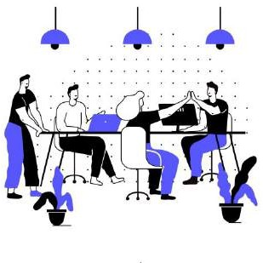
Collaboration
Process in which two or more people or organizations are working together
to achieve a goal.

Slide 8

Critical Thinking
Why critical thinking;
Recognize problems to find
workable means to solve them
Understand the importance of prioritization and order of precedence
Interpret data to appraise evidence and evaluate arguments
Recognize unstated assumptions
or values

Slide 9

Creativity
A phenomenon where something valuable is formed. The created item may be intangible (such as an idea, a scientific theory, a musical composition, or a joke) or a physical object such as an invention, a literary work, or a painting.

Slide 10
Graham Wallas Art of Thought
Stage 1
Stage 2
Stage 3
Stage 4
Stage 5
Preparation
Incubation
Intimation
Illumination
Verification
Verified, elaborated and applied
Focusing on the depth and width of the problem
Internalized into unconscious mind
the Feeling that a solution is on the way
Creative idea bursts from preconscious to conscious awareness

Slide 11
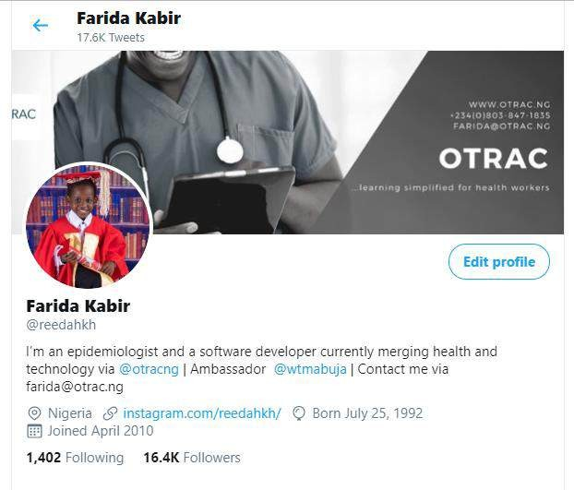
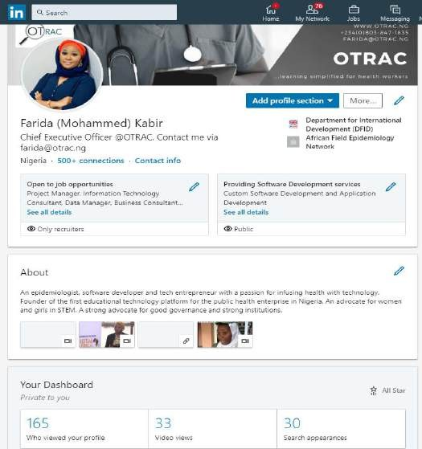
Personal Branding

Slide 12

Ask Yourself
Am I ready for the 21st century job environment?

Slide 13
“The illiterates of the 21st century will not be those who cannot read and write, but rather, those who cannot learn, unlearn and relearn”
- Alvin Toffler

Slide 14
Learn. Unlearn. Relearn

Slide 15

Thanks!
Contact me:
Box Office Incubator, Wuse 2, Abuja.
farida@otrac.ng @reedahkh across all social
media platforms.

