Slide 1


Storage Potential and Germination Characteristics of African Nightshade (Solanum scabrum Mill.) Seed
G.M. FASUSI¹, S.A. AJAYI¹, O.A OYATOMI² and M.T. ABBERTON²
¹Seed Science Laboratory, Department of Crop Production and Protection, Faculty of Agriculture,
Obafemi Awolowo University, Ile-Ife, 220005, Nigeria
² Genetic Resources Center, International Institute of Tropical Agriculture( IITA).
Headquaters and West Africa Hub. PMB 5320, Oyo Road, Ibadan 200001, Oyo State, Nigeria
Corresponding author: (Email: gracefasusi@gmail.com)
1

Slide 2
INTRODUCTION
Family: Solanaceae (Jaegar and Hepper, 1986)
Origin: North America (Muthomi and Musyimi, 2009)
Distribution: West and Central Africa especially in Nigeria, Cameroon and Kenya (Abukusta et al., 2013)
Vegetables (AVRDC, 2006; Nishida et al., 2004)
2

Slide 3
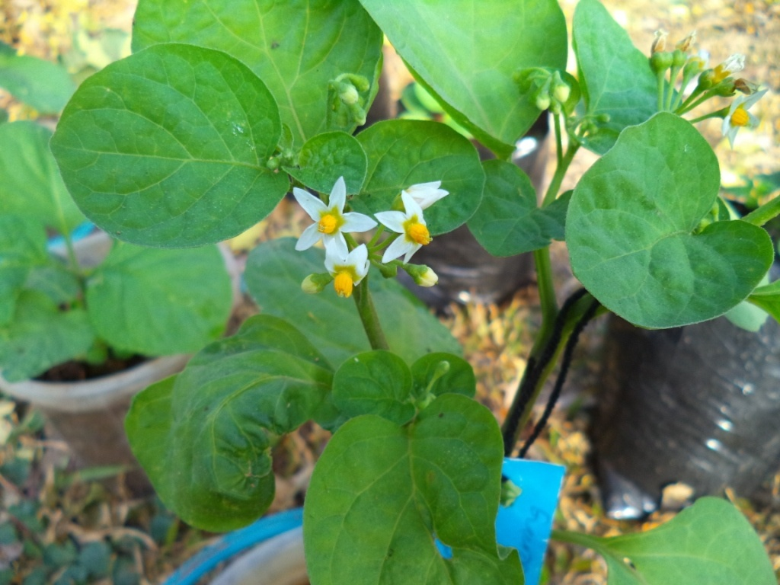
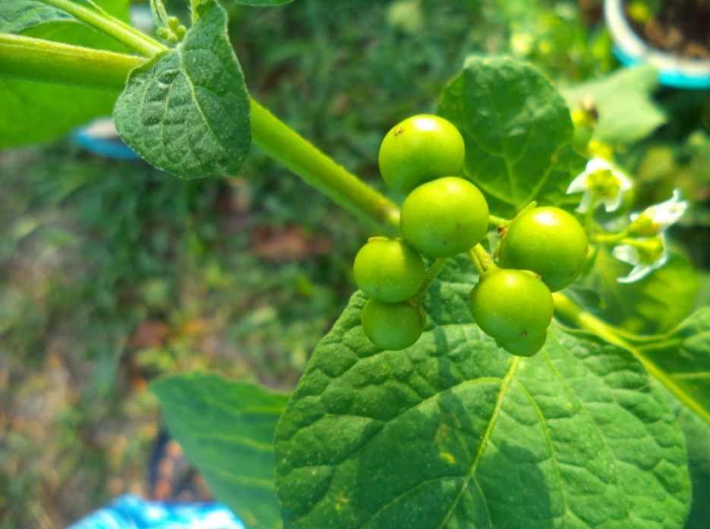
Plate 1: Solanum scabrum mill. plant at reproductive stage and fruit formation stage
3

Slide 4
ECONOMIC IMPORTANCE
food ( Facciola, 1998)
Ornamental plant
Indigenous medicine (Bello et al., 2005)
Green fodder(Fontem and Schippers, 2004)
4

Slide 5
JUSTIFICATION
There is limit to production due to poor seed longevity and farmers have problem with handling of the seeds. Therefore, there is need to improve on their storage potential.
The stage of optimum seed maturity of S. scabrum is yet to be established and there is paucity of information on how this affects the storage of the seeds. (Oladipo, 2016)
5

Slide 6
OBJECTIVES
To compare the effect of seed maturity on germination of S. scabrum
To investigate the effect of storage material on seed longevity of S. scabrum
6

Slide 7
MATERIALS AND METHOD1
Seed collection: IDRC project and Seed Science Laboratory, OAU
Seed sowing
Regular watering
Transplanting
Tagging
Fruit harvesting at 30, 35 and 40 days after anthesis (DAA)
Seed extraction
7

Slide 8
MATERIALS AND METHOD 2
    Moisture Content test
MC% = Initial weight – Final weight x 100
Initial weight
Seed Drying
Storage
Viability test before storage and at 3 & 6 months of seed storage
Germination counts was taken
The following were calculated
  Germination percentage (G%)
G% = Total number of germinated seeds X100
Number of seeds planted
8

Slide 9
MATERIALS AND METHOD 3
Germination index (GI)
GI = ∑ (Nx) (DAP)
Total No. of seedlings that emerged
Where, Nx is the number of seedling(s) that emerge on day x after planting.
DAP is day after planting.
Germination rate index (GRI)
GRI = Germination Index
Germination percentage (0-1) scale
(ISTA, 2007)

Slide 10
Statistical Analysis
Data collected were subjected to statistical analysis using Statistical Analysis Software (SAS) version 9.13 (SAS, 2002).
Analysis of variance (ANOVA) was carried out
Significantly different means were separated using Duncan’s Multiple Range Test (DMRT) at 0.05 probability level.
10

Slide 11
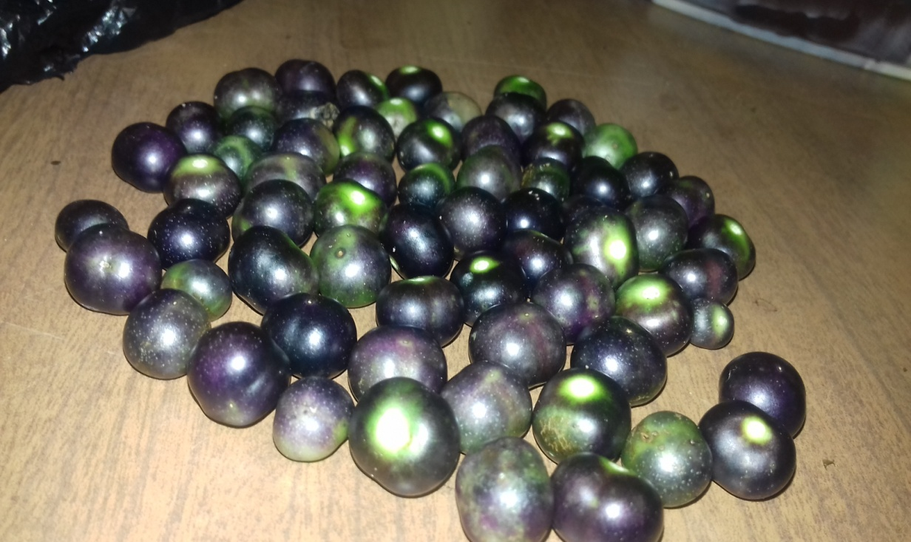
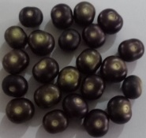
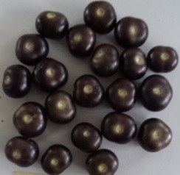
RESULTS AND DISCUSSION
30 DAA
35 DAA
40 DAA
Plate 3: Fruit colour changes at different maturity stages of S. scabrum mill.
11

Slide 12
Figure 2: Relationship between moisture content and germination of Solanum scabrum mill. seeds
12

Slide 13
Figure 3: Effect of maturity stage and duration of storage on germination percentage of Solanum scabrum mill. seeds
DAA: Days after anthesis
13

Slide 14
TABLE 1: Mean values showing the effect of storage material on germination characteristics of Solanum scabrum mill. seeds within the duration of storage.
Beginning |  |  |  | 3 Months |  |  | 6 Months
SM | GPCT(%) | GI(days) | GRI(days) | GPCT(%) | GI(days) | GRI(days) | GPCT(%) | GI(days) | GRI(days)
PB | 90.7a | 5.78a | 6.38a | 82.83a | 6.06a | 7.39a | 68.83a | 4.92a | 7.02a
PL | 90.7a | 5.78a | 6.38a | 86.63a | 5.43b | 6.33b | 77.92a | 4.97a | 9.91a
*Means with the same letter are not significantly different
SM: Storage material GPCT: Germination percentage
PB: Polyethylene bags GI: Germination index
PL: Plastic bottles GRI: Germination rate index
14

Slide 15
CONCLUSION
S. scabrum mill. seeds were not fully matured for storage at 30 DAA but acquired storage potential at 40 DAA
Storage material had no effect on the viability of S. scabrum mill. seeds
15

Slide 16
ACKNOWLEDGEMENT
Prof M.T. Abberton
Dr O.A. Oyatomi
Dr F.A. Awosanmi
16

Slide 17
REFERENCES1
Abukusta-Onyango, M. O.; Agong, S. G.; Mwai, G. N.; Nono-Womdim, R.; Ojiewo, C. O. (2013). “Exploiting the Genetic Diversity of Vegetable African Nightshades”. Global Science Books. Retrieved November 16, 2013
AOCC African Orphan Crops Consortium (2015). Solanum scabrum, pp:1-6
Asian Vegetable Research and Development Center (2006). Vegetables Matter. AVRDC – The World Vegetable Center. Shanhua, Taiwan.
Bello S.O., Muhammad B.Y., Gammaniel K.S., Abdu-Aguye I., Ahmed H., Njoku C.H., Pindiga U. H. and Salka A.M., (2005) Preliminary Evaluation of the Toxicity and Some Pharmacological Properties of the Aqueous Crude Extract of Solanum melongena., Res. J. Agric. Biol. Sci.,1(1), 1-9
17

Slide 18
REFERENCES 2
Facciola, S. (1998). Cornucopia II.Kampong Publications. California ISBN 0-9628087-2-5.
Fontem, D. A. and Schippers, R. R. (2004). Solanum scabrum Mill. In: Grubben, G. J. H. and Denton, O. A. (eds) Plant Resources of Tropical Africa 2. Vegetables, PROTA Foundation Wageningen/CTAWageningen/ Backhuys Publishers, Leiden, Netherlands, pp. 493–498.
Idowu, M.K., Oyedele, D.J., Adekunle, O.K., Akinremi, O.O. and Eilers, B. (2014). Effects of Planting Methods and Seed Density on Vegetable Yield and Nutrient Composition of Solanum macrocarpon and Solanum scabrum in Southwest Nigeria. Food and Nutrition Sciences, 5, 1185-1195.
Jaeger P.M.L. and Hepper F. N.(1986). A review of the genus Solanum in Africa, In: Solanaceae: biology and systematics (eds) W. G. D.Arcy (New York: Columbia University Press) 41–55.
18

Slide 19
REFERENCES 3
Muthomi, J. and D.M. Musyimi, 2009. Growth Responses of African Nightshades (Solanumscabrum MILL)Seedlings to Water Deficit. Journal of Agricultural and Biological Science, 4(5): 116-120.
Oladipo,V.O.(2016). Influence of Seed Extraction and Drying Methods on the Longevity of African Nightshade (Solanum scabrum. Mill) seeds. Unpublished master’s thesis. p.77
19

Slide 20
THANK YOU FOR LISTENING
20

