Slide 1
Evaluation of Some Tomato Cultivars for infestation with whitefly, Bemicia tabaci Genn. ( Homoptera, Aleyrodidae)
By
Manasic Mohamadain ,Abdalla M.abdalla and Sana K.Mukhtar
October 2009

Slide 2
Road map:
Introduction
Objectives
Methodology
Preliminary results
Discussion
conclusion
Recommendations

Slide 3
Introduction:
Why Bara area?
Why tomato?
Why whitefly?
Why ……?

Slide 4
Objectives:
This Study covers the following objectives:
To assess the whitefly population

Slide 5
Methodology
Study area:
To achieve the above mentioned objectives, four tomato cultivars were selected:
Alla Kareem
Strain B
Peto 86
Castle Rock
Development f seedlings in the nursery (GARC)
Transplanting of seedlings in the field ( Bara)
The experiment depend on natural White fly infestation in Bara after transplanting process take place

Slide 6
Methodology Cont…
Experimental Layout
I
II
III
IV
strain B
Castle rock
Peto 86
Alla kaream
Alla kaream
Peto 86
strain B
Castle rock
Castle rock
strain B
Alla kaream
Peto 86
Peto 86
Alla kaream
Castle rock
strain B

Slide 7
Results
0.28 ± 5.4
0.25 ± 5.4
0.23 ± 5.4
0.18 ± 5.4
Fig 1 : Population of whitefly Bemisia tabaci (Homoptera, Aleyrodidae) in the varieties of tomato plant season 07/2008
1.39 ± 0.2
1.3 ±0.2
0.71 ± 0.2
0.3 ± 0.2
Fig 2: Population of whitefly Bemisia tabaci (Homoptera, Aleyrodidae) in the varieties of tomato plant season 08/2009

Slide 8
Results cont..
Fig 3: Population of Whitefly from different variety of Tomato plant Season (07/08 and08\09

Slide 9
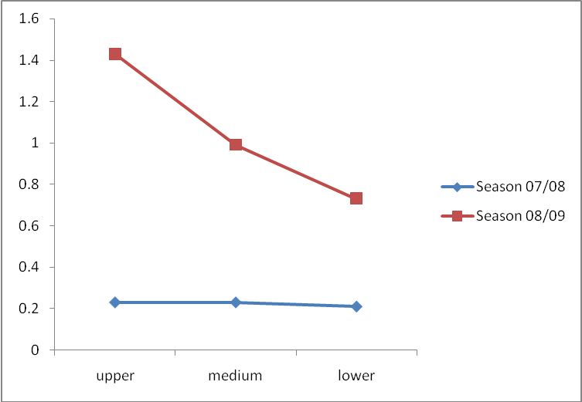
Results cont..
1.43 ±0.2
0.99 ±0.2
0.73 ±02
0.23 ± 0.01
0.23 ± 0.01
0.21 ± 0.01
Number of whitefly in the different parts of tomato plant season 07/08 & 08/09

Slide 10
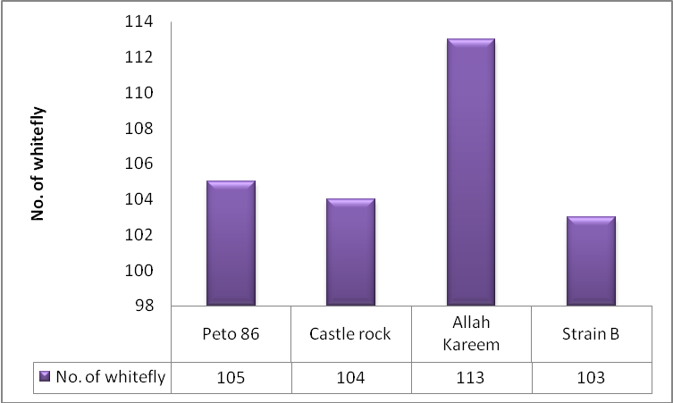
Results cont..
113 ± 15.1
105 ± 2.6
104 ± 9.9
103 ± 9.3
Fig 1: Population of Bemisia tabaci (Homoptera, Aleyrodidae) recorded in sticky trap from different varieties of tomato plant season 07/2008

Slide 11
Results cont..
Mean ± SD =107 ± 9.2
Fig : Population of Bemisia tabaci (Homoptera, Aleyrodidae) recorded in sticky trap from two directions North and South season 07/2008

Slide 12
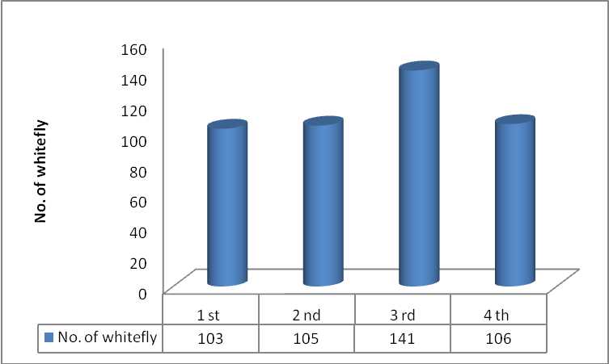
Results cont..
141ª±45.5
103^{b}±28.2
105^{b}±24.6
106^{b}±28.7
Fig 2 : Population of whitefly Bemisia tabaci (Homoptera, Aleyrodidae) recorded from sticky trap from tomato plant from 1 st. to 4 th. Week season 07/2008

Slide 13
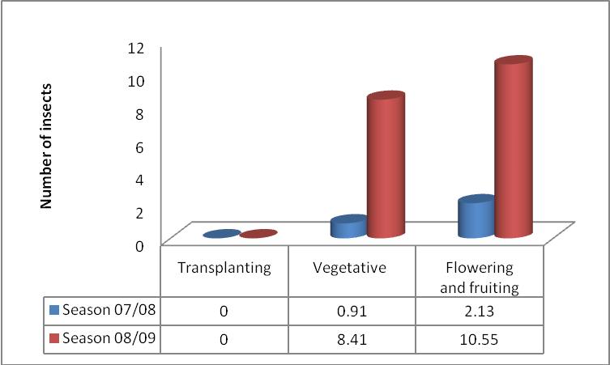
Results cont..
Number of insect in different stages of tomato plant in season 07/08 & 08/09

Slide 14
Discussions

Slide 15
Recommendations

Slide 16

Thank You for Your Attention

