Slide 1
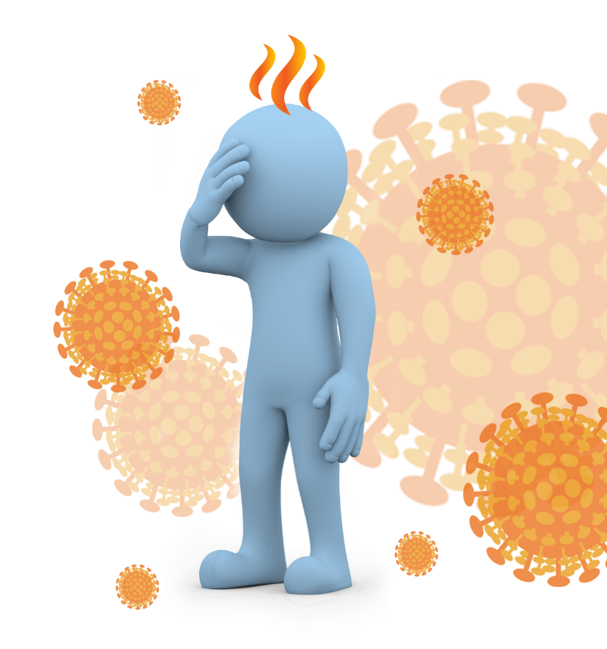
Coronavirus disease (COVID -19)
By Estele Mwanza

Slide 2
Profile
Diploma in General Nursing
Diploma in Midwifery
Certificate in Family Planning
Certificate in managing Sexually transmitted Infections
BSc Nursing Science
MSc Nursing Science ( Maternal and Child Health)
Post graduate Diploma in Nutrition and Food Security
Matron at Mashoko Christian Hospital
Lecturer at BUSE since 2006
Chairperson in the Department of Health Sciences -20113-2019
Matron at Mashoko Christian Hospital
A mother of two

Slide 3
Introduction
Coronavirus disease (COVID -19) is an infectious (communicable) respiratory disease caused by a new strain of corona virus.
It is new virus and the disease was unknown before the outbreak began in Wuhan, China in December 2019.

Slide 4
Causative organism
SARS-CoV2 (previously 2019-nCoV) is the virus that causes coronavirus disease of 2019 (COVID-19)
N.B. SARS - Severe Acute Respiratory Syndrome

Slide 5
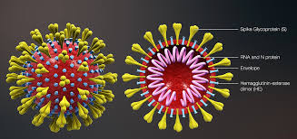
CORONA VIRUS STRUCTURE

Slide 6
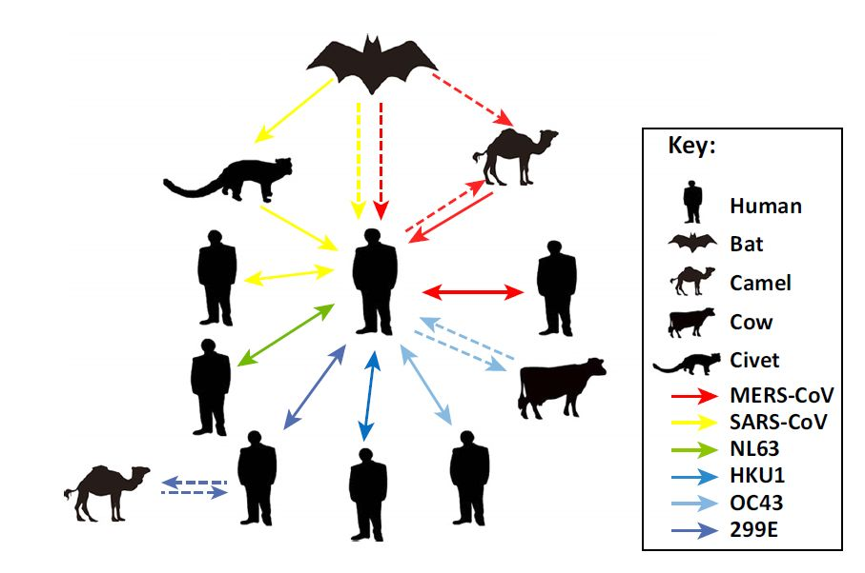
Sources of CoV

Slide 7
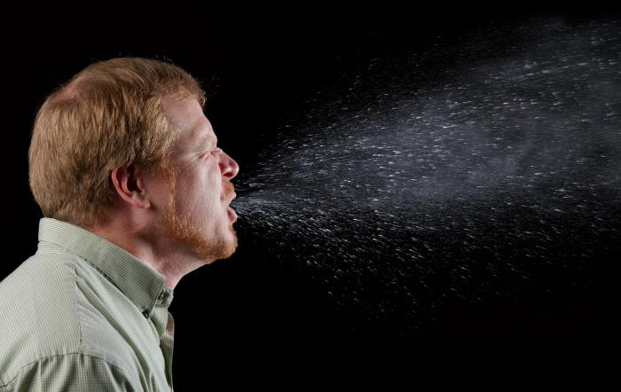
How is COVID-19 spread?
SARS CoV-2 is released when an infected person sneezes, coughs, or talks and releases droplets that contain the virus – DROPLET TRANSMISSION

Slide 8
Pathogens are transmitted from the respiratory tract of an infected person
Droplets do not remain suspended in air for long and generally travel short distances (1 metre or less)
Transmission from droplets therefore requires close contact between infected source and recipient
Droplets can also contaminate the surrounding environment, including people’s hands

Slide 9
Other routes of transmission
(spread )of SARS CoV-2
Touching objects/surfaces or skin contaminated with infectious droplets then touching eyes, nose or mouth – CONTACT TRANSMISSION

Slide 10
Survival of coronaviruses in the environment
Coronaviruses can survive on surfaces from 3hrs to 9 days (the lower the temperature the longer the survival time)
SARS-CoV2 survives 72 hrs on plastic and steel surfaces longer than cardboard and copper surfaces
Susceptible to ethanol (62-71%), sodium hypochlorite (0.1%), povidone iodine, glutaraldehyde and formaldehyde

Slide 11
Common symptoms
Fever
Chills including rigors
(chills with shaking)
Fatigue
Cough
Sore throat
Shortness of breath and
breathing difficulty
Runny nose
More severe cases can cause pneumonia, severe acute respiratory syndrome, kidney failure, and even death

Slide 12
Symptoms start about one day after
exposure, but can be as long as 14 days.
    Some people have no symptoms, most have a mild illness.
    It can be severe and sometimes fatal.

Slide 13
Less common symptoms
Headache
muscle aches
Diarrhoea
Sudden loss of sense of smell and taste
Abnormal heart rhythm and heart failure
Stroke

Slide 14
Diagnosis and treatment
Because symptoms are similar to many other illnesses, tests are needed to make the diagnosis (nose/ throat swab, blood test).
There is no specific treatment.
Mild symptoms can be treated with medicine to lower the fever, or relieve pain.
If symptoms are more severe, treatment in hospital is required

Slide 15
To prevent COVID-19
Wash your hands frequently with soap and water.
Use alcohol-based hand sanitiser when soap and
water are not readily available.
Cover your coughs and sneezes. Use a tissue or your
upper sleeve. Immediately throw the tissue in a bin and wash your hands.
Wear a mask/face covering/ fabric mask in public places, especially when it is difficult to maintain 1-2 metres (3-6 feet) distance from others.

Slide 16
Avoid touching shared objects (light switches, handrails, door handles etc) as much as possible.
If you must touch such objects, wash your hands or use sanitiser promptly afterwards. Ensure you do not touch your face.
Clean and disinfect frequently touched surfaces each day, more often if you think they’ve been contaminated.
Do not share food, drinks and personal items including mobile phones

Slide 17
Avoid activities which expose you to large groups of people.
Maintain social distance while greeting visitors. Avoid shaking hands, kissing or hugging.
Work from home, where possible.
Avoid non-essential travel.
Keep away from people who are sick – don’t let them cough or sneeze on you.
Avoid visiting hospitals and other medical facilities unless you need medical care.

Slide 18
Mental health & COVID-19
Fear, worry, and stress are normal responses to perceived or real threats, and at times when we are faced with uncertainty or the unknown.
So it is normal and understandable that people are experiencing fear in the context of the COVID-19 pandemic.

Slide 19
Fear of contracting the virus in a pandemic such as COVID-19 are the significant changes to our daily lives as our movements are restricted in support of efforts to contain and slow down the spread of the virus.
Faced with new realities of working from home, temporary unemployment, home-schooling of children, and lack of physical contact with other family members, friends and colleagues, it is important that we look after our mental, as well as our physical, health.

Slide 20
Coping with stress during the COVID-19 outbreak
    Things you can do to reduce stress:
    Take breaks from listening to, watching or reading about COVID-19 frequently, including social media.
    Focus on the facts of COVID-19 and understand the risk to yourself and those you care about.
    Separate facts from rumours. Gather information from reliable sources.
    If stress continues to hamper your daily activities, talk to a doctor, or someone you can trust.

Slide 21

*Keep yourself in the best possible health.
Sleep well, eat healthy and be physically active*

Slide 22
SIYABONGA
TATENDA
THANK YOU
ZIKOMO
TWALUMBA

