Slide 1


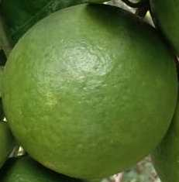

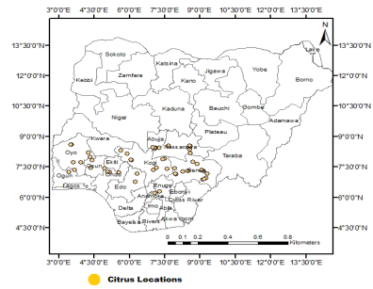
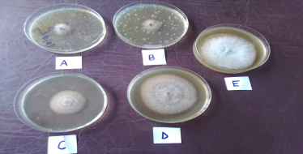
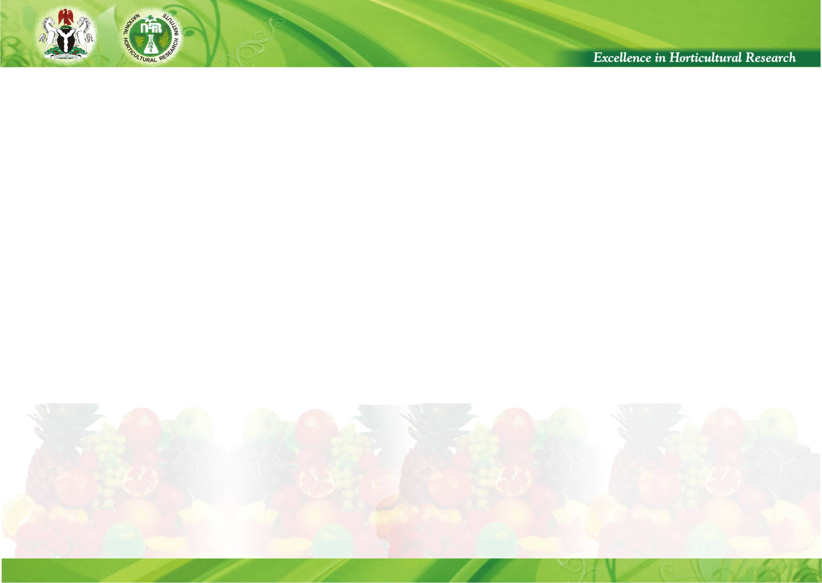

Incidence, pathogenicity and control of fruit spots in major citrus growing areas of Nigeria
E.I. Nwanguma, * E.O. Oyedeji, A.O. Oke, V.C. Umeh, V.A. Chikaleke, B.N. Okafor, O.O. Alamu, R.B. Ibe, R.K. Egberongbe, O. Arogundade, B.O. Oyewole, O.O. Oso and C.G. Elum
National Horticultural Research Institute, Ibadan Nigeria *Presenting author : nwangumaei@yahoo.com Tel: +2348163319956
Introduction
Fruit and leaf spots are among the most common and damaging diseases of tropical fruit crops including citrus (De Silva et al. 2017). This study therefore, evaluated the incidence and severity of fruit spot disease in major citrus growing areas in Nigeria and identified the causal pathogen(s) in order to develop sustainable management strategies to curtail its spread.
Plate 1a:Healthy fruit
Plate 1b: infected fruit
Table 1: Incidence and severity of fruit and leaf spots of citrus in major citrus growing states of Nigeria.
Damaged boll.
Materials and Methods
Study area and disease assessment
Incidence, prevalence and severity of citrus fruit spot was assessd in 38 orchards in major citrus growing areas of Nigeria; Ekiti, Ogun, Ondo, Osun and Oyo (South-west), Kogi, Nasarawa and Benue (North central) and Edo, Delta (South south), Enugu and Anambra (South east) (Figure 1). Stratified Random Sampling method was adopted. Ten trees were sampled per location and rated on a scale of 1-5. Disease incidence and severity was then obtained using the following formulae:
Disease incidence (DI) = X ×100
N
Disease severity(DS) = ∑ (X × 100)
NR × MCS
Where:X = infected fruits and their corresponding score scale
NR = Total number of fruits sampled
MCS = Maximum score of the scale (5)
Laboratory assay
Efficacies of Redforce (a.i Metalaxyl-M 6% + Copper (1) oxide 60 % WP), Hat-trick (a.i 40% Hexaconazole), Neem force (a.i Azadirachtin and NIHORT-Lyptol (a.i Cineole) were tested in vitro on isolated pathogens using pour plate technique. Fungitoxicity was expressed as percentage inhibition of mycelia growth using the formular adopted from (Awuah, 1989);
Mp = M₁ - M₂ × 100
M₁
Where: Mp =Percentage inhibition of mycelia growth; M₁ = Mycelia growth in control plate;
M₂ = Mycelia growth in fungicide treated plate
Figure 1: A map showing the states surveyed for incidence and severity of citrus fruit spot
Results
Nasarawa state had incidence of 76.67 % while Osun state recorded 75.00 %. Incidence in Oyo, Ondo, Benue, Kogi and ogun states were 39.17, 26.67, 40.00 26.67 and 11.6 % respectively Table 1. No incidence in Edo, Enugu, Delta and Anambra states.
Mycelia inhibition of C. gloeosporioides by NIHORT-Lyptol was higher (84.0%) than Hat-trick (73.0 %), Redforce (70.0%) and Neem force (27.0%) Table 2; plate 2.
Table 1: Incidence and severity of fruit and leaf spots of citrus in major citrus growing states of Nigeria.
Table 2: In vitro efficacies of some selected fungicides and bio pesticide on fungi associated with citrus fruit spots
Location/ states | Incidence (%) | Severity | Rating
Oyo | 39.17b | 3.33ab | Moderate
Osun | 75.00a | 4.33a | Severe
Ogun | 11.67b | 1.33b | Mild
Ondo | 26.67b | 2.67ab | Moderate
Nasarawa | 76.67a | 4.00a | Severe
Benue | 40.00b | 2.33ab | Moderate
Kogi | 26.57b | 2.00ab | Mild
Means of reduction in radial growth
Treatment | Recommended rate/ha | C. gloeosporioides | L. pseudotheobromae
Neemforce | 500L | 5.63b (37.4) | 8.00a (11.1)
Lyptol | 20L | 1.67c (81.4) | 3.17b (64.8)
Redforce | 800 gms | 2.40 (73.3) | 4.28b (52.4)
Hatrick | 65-175 ml/500L of water | 2.57c (70.3) | 3.17b (64.8)
Control | - | 9.00a(0.00) | 9.00a (0.00)
Values in parenthesis are percentage reduction in radial growth. Values are obtained from means of 4 replicates of fungal pathogen per treatment. Means with the same alphabet in the same column are not significantly different (P≤0.05) Student-Newman-Keuls Multiple-Test
Means with the same alphabet in the same column are not significantly different (P≤0.05) Student-Newman-Keuls Multiple-Test
Plate 2: Mycelial inhibition of Colletotrichum gloeosporioides by different Fungicides A: Hat trick B: NIHORTLyptol C: Red-force different fungicideA: Hat trick B: NIHORT Lyptol D: Neem force E: Control without fungicide
Conclusion
This study revealed the incidence of fruit and leaf spots disease in Nigeria.. NIHORT-Lyptol compared favourably with Hat-trick in its potential control of the disease.

